Slide 1
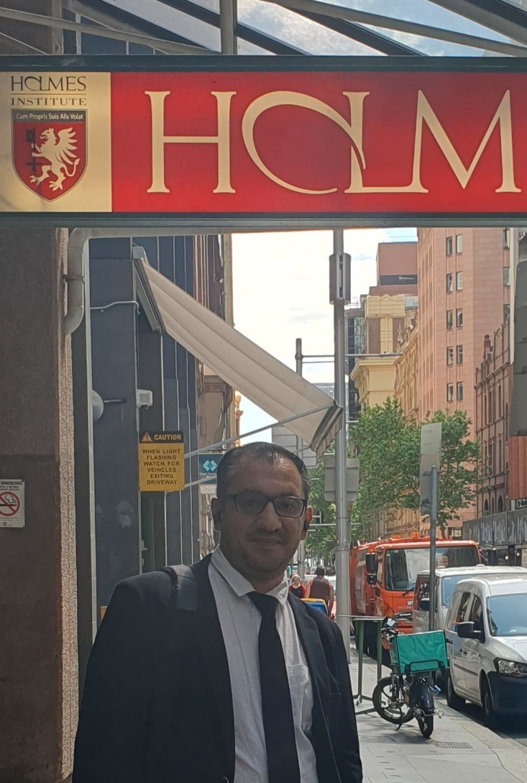

HS1021: Web Design
Weeks 4 – 5 Tutorial and
Lab 2 Test Practice
Dr. Farshid Keivanian

Slide 2

Weeks 4 - 5 Tutorial
Lecture 3, titled "Web Design Basics," covered the essential aspects of HTML and webpage design. The key objectives were to manage website files effectively, utilize HTML5 semantic elements, and construct the structural design of a webpage. The lecture also emphasized designing a semantic wireframe, creating and validating webpage templates, and adding unique content tailored to specific needs. It discussed the importance of understanding a website's purpose, its target audience, and ensuring an optimal viewing experience across different devices. Practical examples included creating a basic site map, organizing files within a website, and incorporating static and dynamic content to enhance the user experience.

Slide 3
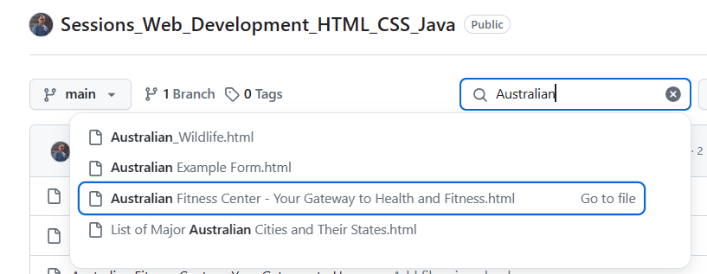
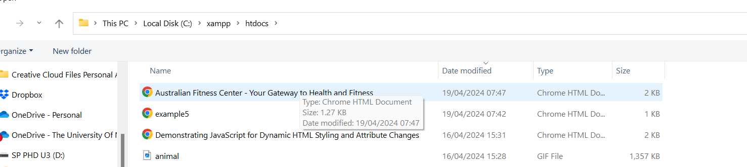
Practical Example: Creating an HTML Page for an Australian Fitness Center
A simple example of an HTML page for a fitness center based in Australia, following the guidelines from the lecture:
This HTML template uses semantic elements like <header>, <nav>, <main>, and <footer> to structure the webpage effectively. Each section is clearly defined, making the content accessible and the page easier to navigate, aligning with the best practices discussed in the lecture. This structure also aids in SEO and ensures compatibility across various devices, catering to the needs of a diverse Australian audience.
Change it and Save it in C:\\Xampp >> htdocs

Slide 4
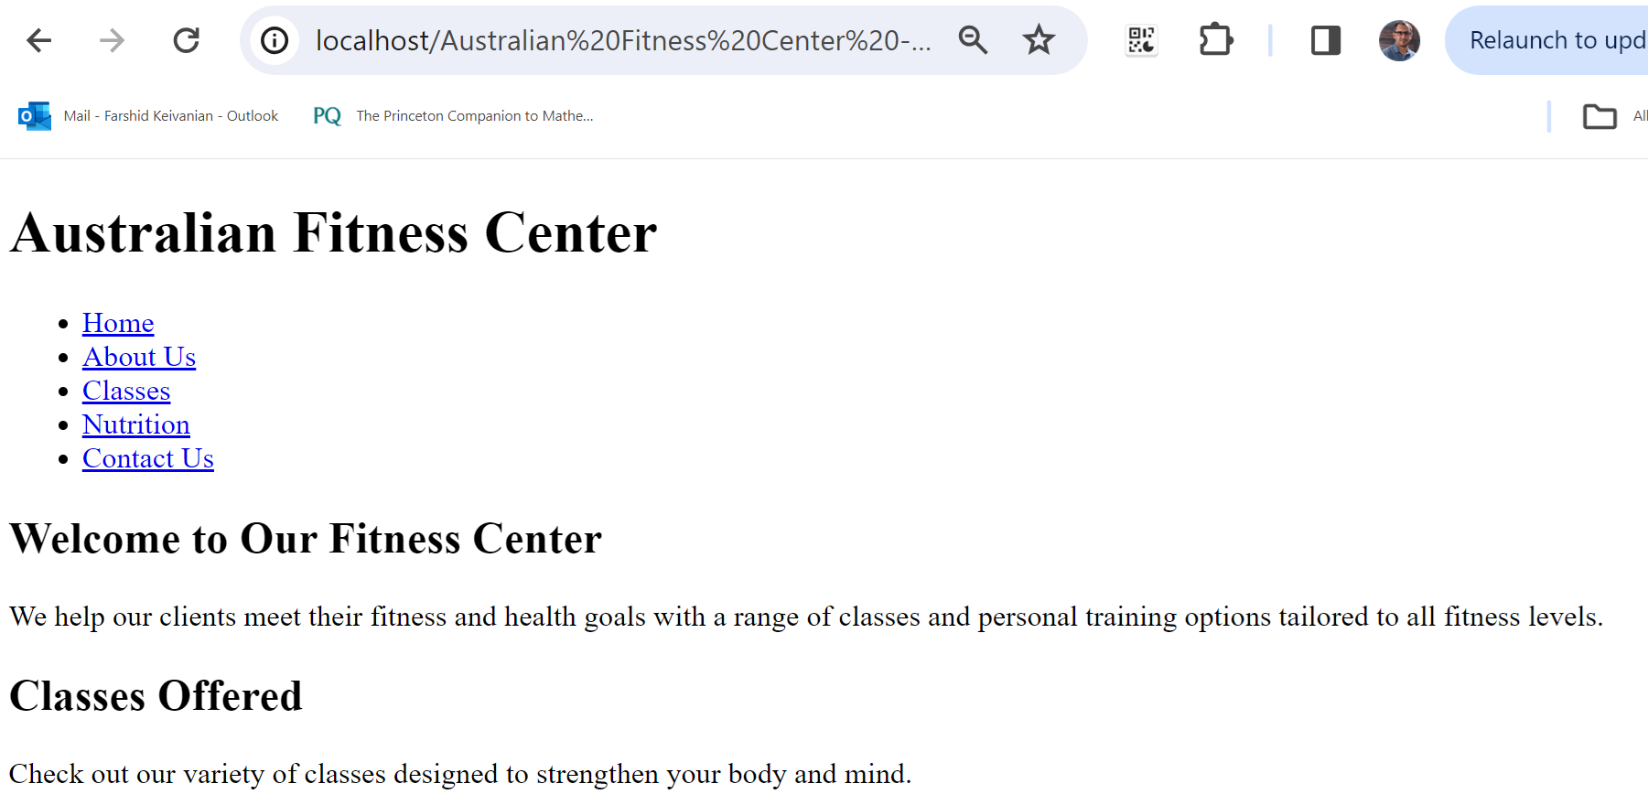
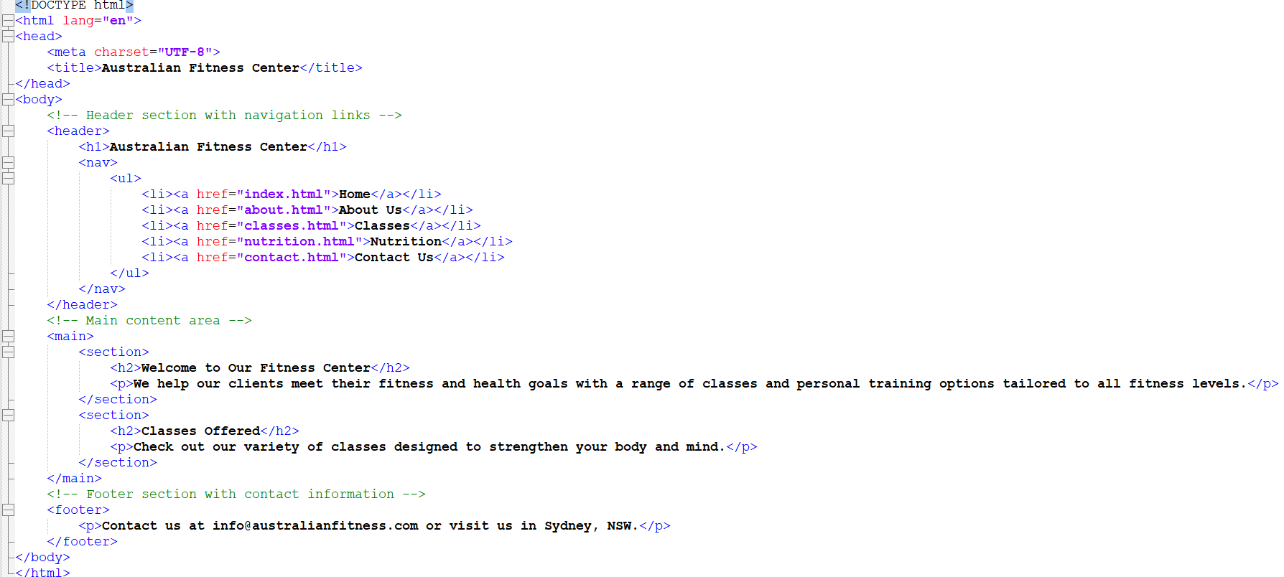
Practical Example
The code is available online for my students!

Slide 5
Weeks 4 - 5 Tutorial
The purpose of the tutorial as detailed in the provided documents is to practice and understand the application of semantic HTML5 elements within the structure of a web page, and to apply CSS styling techniques to enhance the presentation of the content. This assignment ties into the overall learning goals of web design in several ways:
Understanding Semantic HTML: By creating a template with semantic wireframe elements like header, nav, main, and footer, you learn the importance of semantic HTML in web design. Semantic HTML5 elements convey meaning about the type of content they contain, not just its appearance, which is crucial for accessibility and search engine optimization (SEO).
Practical Application: The tasks require you to apply the concepts learned in lectures by creating a webpage template and styling it using CSS. This solidifies your theoretical knowledge through practical application.

Slide 6
Weeks 4 - 5 Tutorial
Research and Documentation: The assignment asks you to research various HTML elements and document your findings as comments in the code, promoting the skill of self-learning and the importance of code documentation for future reference.
Webpage Validation: By validating the webpage using the W3C validator, you ensure that the HTML and CSS code adheres to web standards, which is important for cross-browser compatibility and long-term maintainability of the code.
Styling with CSS: The project requires the use of external, embedded, and inline CSS to style the webpage, giving you hands-on experience with different methods of applying styles, and understanding the advantages and best use-cases for each method.

Slide 7
Weeks 4 - 5 Tutorial
6. CSS Layout Techniques: You will practice CSS layout techniques such as using the float property and the margin property to align elements, which are essential skills for creating visually appealing and well-structured web pages.
7. Problem Solving and Debugging:
In summary, this assignment is designed to develop a comprehensive set of web design skills, from understanding the structure and semantics of HTML to applying styles and layouts with CSS. These are fundamental skills for any web designer or developer and are essential for creating efficient, accessible, and maintainable web pages​

Slide 8
Weeks 4 - 5 Tutorial
Use the apply02.docx document and the Weeks 4-5 Lab.pdf as guides through each task. For HTML and CSS syntax, you can refer to Notepadd++ or web resources such as https://w3schools.com/
Given the instructions and details from the Weeks 4-5 Lab PDF and the apply02.docx, let's write the HTML code needed to create a web page template with semantic HTML5 elements and then style it with CSS.

Slide 9
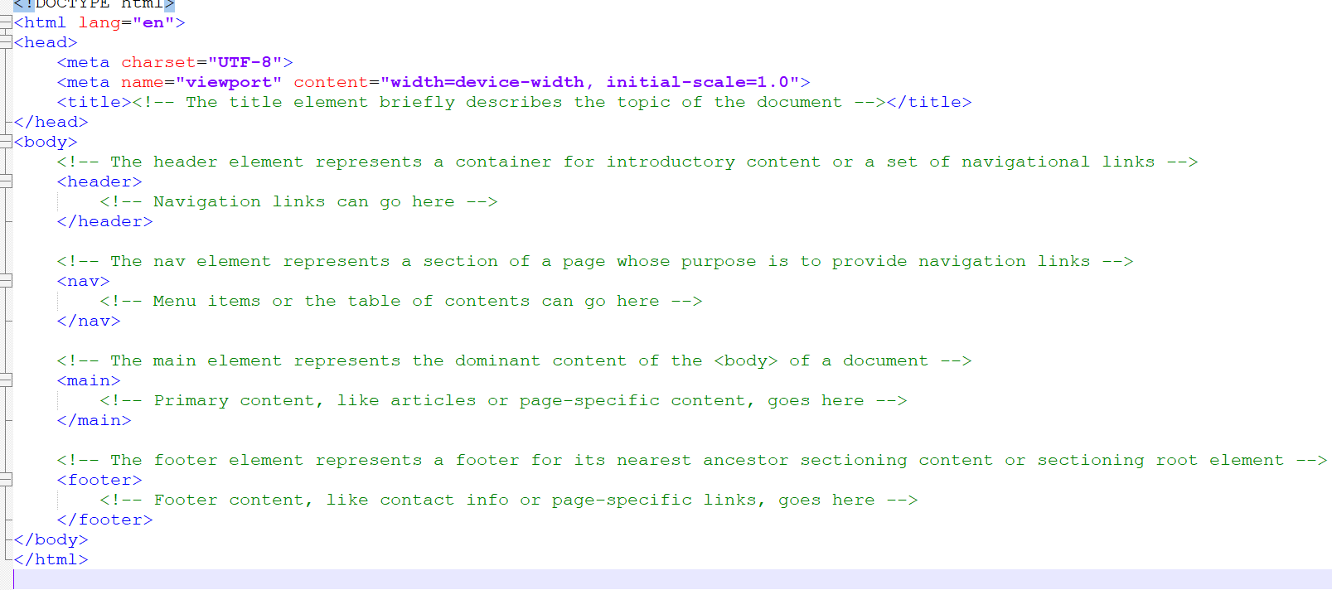
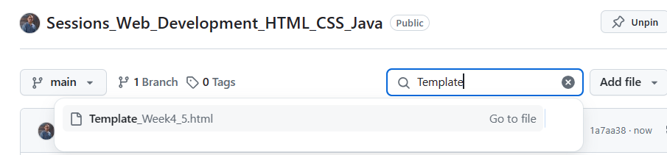
Weeks 4 - 5 Tutorial
Step 1) HTML Code for Template Creation (template02.html)
Here's the basic structure with semantic HTML5 elements and HTML comments to indicate the type of content each section should contain:
Please always change, showcase your coding skills, then save it as html extension in file in C:\xampp\htdocs

Slide 10
Weeks 4 - 5 Tutorial – Understanding the Main Document
Project 1: Creating a Template with a Semantic Wireframe
HTML Tags Entry: Use an HTML editor to enter HTML tags for creating a webpage template with semantic HTML5 structural tags.
You will need to input HTML tags as specified in the document and use indents to make the code readable.

Slide 11
Weeks 4 - 5 Tutorial – Understanding the Main Document
2. Title Element Research:
Utilise a search engine to understand the <‘title’> element and document findings as HTML comments. You need to research what a title element is and its importance for a web page.
3. Applying Research:
Save the webpage addresses used for research in the apply02.docx document.
This involves documenting sources of your research for future reference or validation.

Slide 12
Weeks 4 - 5 Tutorial – Understanding the Main Document
4. Semantic HTML Research: You will need to answer specific questions about semantic HTML5 elements (header, nav, main, footer) using a search engine.
This will require you to understand what each tag represents and its role in the structure of a webpage.
5. HTML Commenting: Replace comments with researched answers in the template02.html document.
You will replace placeholder comments with the appropriate explanations as HTML comments.
6. Validation with W3C: Validate the template02.html document using W3C validator and correct any issues.
This step ensures that the HTML code adheres to current web standards.

Slide 13
Project 2: Styling a Webpage
CSS Styling: Create styles for the semantic wireframe sections (header, nav, main, footer) and a div element.
You will create an external stylesheet, link it to the HTML document, and apply styles as instructed.
Centering Content: Use CSS to center content within a div wrapper.
A specific div with an id of outerwrapper will be styled to center the page content.
Font Family Styling: Apply sans-serif and serif fonts to different sections of the webpage.
This requires understanding which font styles are appropriate for various parts of a webpage.

Slide 14
Project 2: Styling a Webpage
4. Image Floating: Float an image to the left and clear the float where necessary.
You will learn how to manipulate text flow around images.
5. Margins, Borders, and Professional Touch: Add margins and borders to the page elements to make the page look professional.
This teaches the aesthetic spacing and bordering of page elements.
6. Embedded and Inline Styles: Use different methods of CSS application (external, embedded, and inline) and understand their use cases.
You will apply CSS directly within the HTML document for specific elements.
7. Code Validation and Submission: Validate the code again using W3C and submit the files as per instructor's format.

Slide 15
Weeks 4 - 5 Tutorial – Understanding the Code - Main Document
Document Type and Meta Information:
<!DOCTYPE html>: Declares the document type and version of HTML (HTML5).
<meta charset="UTF-8">: Specifies the character encoding for the webpage (UTF-8).
<meta name="viewport" content="width=device-width, initial-scale=1.0">: Ensures the page is optimized for responsive design.
<title>: The title of the document, which appears in the browser tab; it should describe the topic or contents of the document.

Slide 16
Weeks 4 - 5 Tutorial – Understanding the Code - Main Document
2. Structural Elements:
<header>: Typically contains introductory content or navigation links. It's the first thing users see in the "body" of the document.
<nav>: Dedicated to navigation links, helping users navigate the site or app.
<main>: The core content of the webpage, distinct from sidebars, footers, and navigation bars. It's the primary focus of the document.
<footer>: Contains auxiliary information like copyrights, links to privacy policies, or contact info.

Slide 17
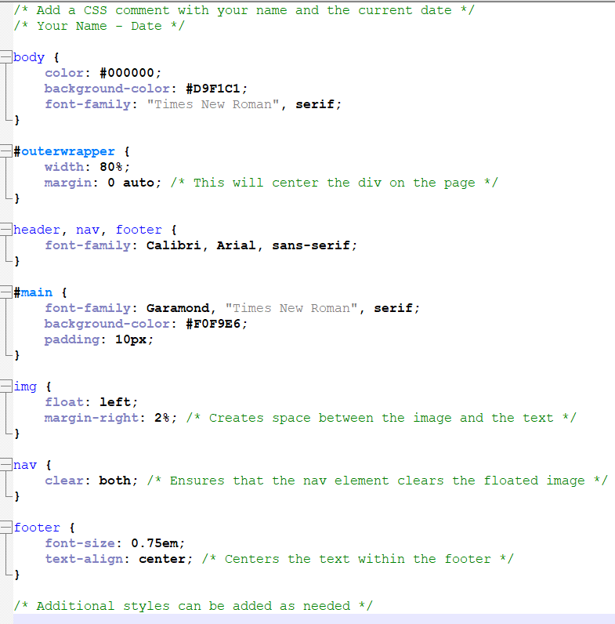
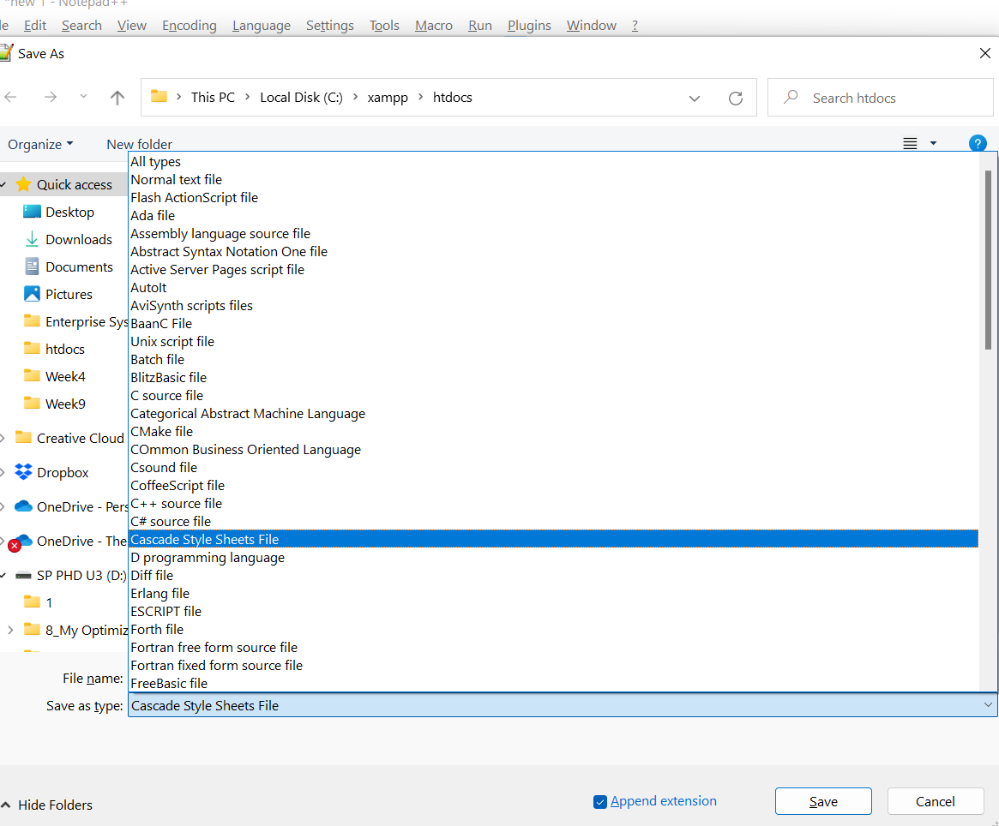
Step 2) CSS Styling for the Template (styles.css) - Please always change, showcase your coding skills, then save it as Cascade Style Sheets File (CSS) extension in file in C:\xampp\htdocs

Slide 18
Explanation of the CSS code: 1. Comment with name and date: This part of the code is a and the current date. Comments in CSS are ignored by browsers and serve only for documentation purposes.
/* Your Name – Date */

Slide 19
2. Body Styling:
color: #000000;: This sets the text color of the entire document to black.
background-color: #D9F1C1;: The background color of the entire page is set to a light green.
font-family: "Times New Roman", serif;: The default font for the page is set to Times New Roman with a fallback to any generic serif font if Times New Roman is not available.

Slide 20
3. Outer Wrapper:
width: 80%;: The width of the #outerwrapper element is set to 80% of its parent element, typically the body.
margin: 0 auto;: This centers the #outerwrapper element horizontally within its parent element.
4. Header, Nav, Footer Styling:
font-family: Calibri, Arial, sans-serif;: These elements are styled with a sans-serif font, preferring Calibri or Arial.

Slide 21
5. Main Section Styling:
font-family: Garamond, "Times New Roman", serif;: The text within the #main section uses Garamond, with Times New Roman as a fallback.
background-color: #F0F9E6;: A lighter shade of green is set as the background color.
padding: 10px;: Adds padding around the content inside the #main section, increasing its readability.
6. Image Styling:
float: left;: Images will float to the left, allowing text to wrap around on the right.
margin-right: 2%;: Adds a right margin to the images, creating space between them and any adjacent content.

Slide 22
7. Navigation Clearing:
clear: both;: Ensures that the nav element does not wrap around any floated elements above it, effectively clearing previous floats.
8. Footer Styling:
font-size: 0.75em;: The font size in the footer is smaller than the rest of the text.
text-align: center;: Centers the text within the footer.

Slide 23
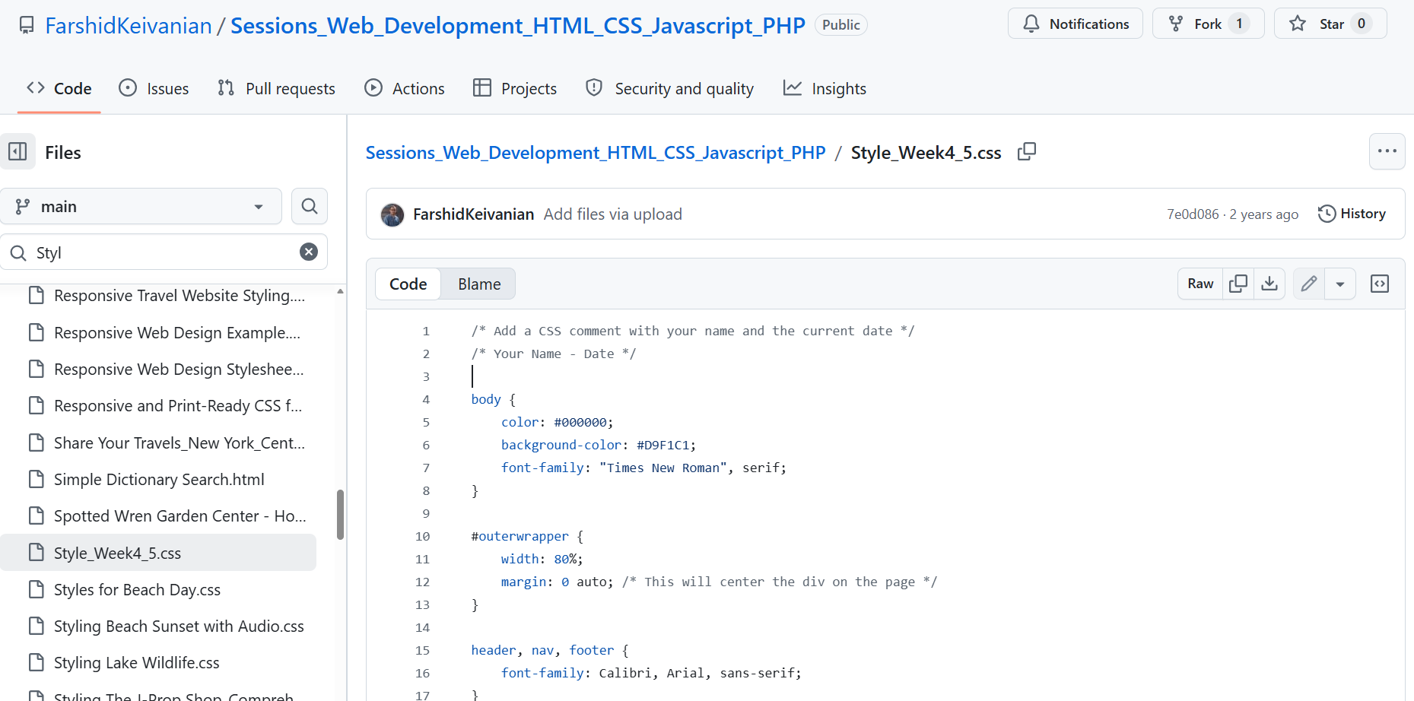
Download Style_Week4_5.css file from GitHub

Slide 24
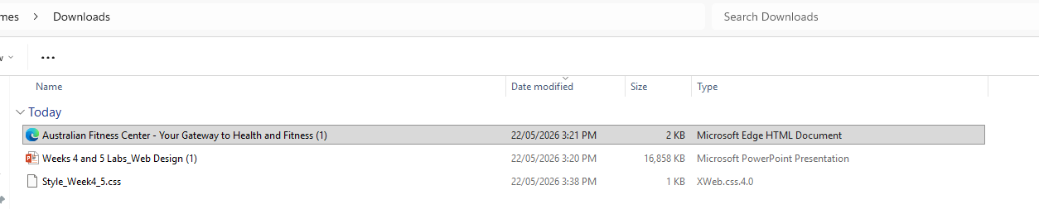
Make sure both CSS and HTML files are in the same folder

Slide 25
Step 3) Linking the CSS to HTML
In the <head> of the HTML document, add the link to the external CSS file:
Remember to validate your HTML and CSS using the W3C validators to ensure that there are no errors in your code​​. Also, you may need to replace placeholders with actual content and URLs based on the project requirements.
To link the external CSS file to the HTML document, we'll need to place the link tag inside the <head> section of your HTML code. Assuming your CSS file is named “Style_Week4_5.css" and it's located in the same directory as our HTML file, here is how we would modify the HTML

Slide 26
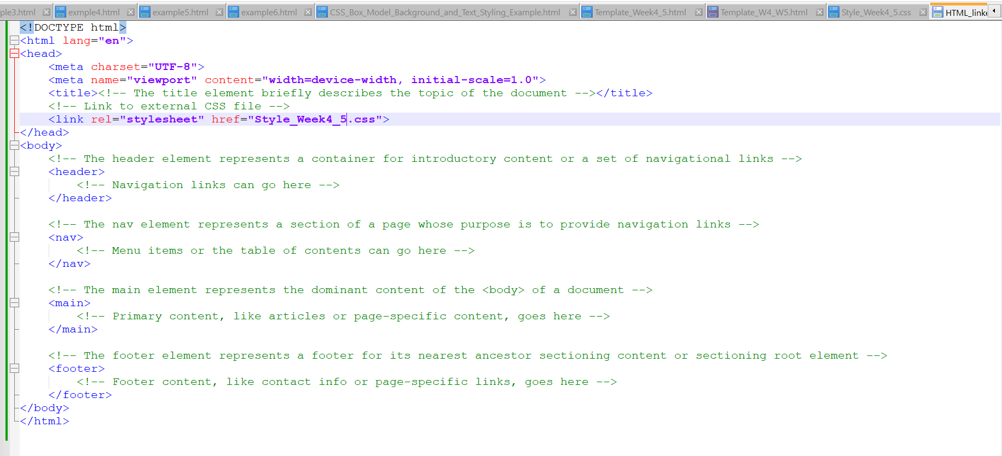
Add this line (Link to CSS file)
Ensure that the path in the href attribute correctly points to the location of our CSS file. If the CSS file is in a subfolder, for instance, a folder named "css", the href would be css/Style_Week4_5.css. If it's in the same directory, just using Style_Week4_5.css as shown above is sufficient.
Remember that the name of the CSS file in the href attribute must match exactly the name of the CSS file we've created, including letter case, as some servers are case-sensitive.

Slide 27
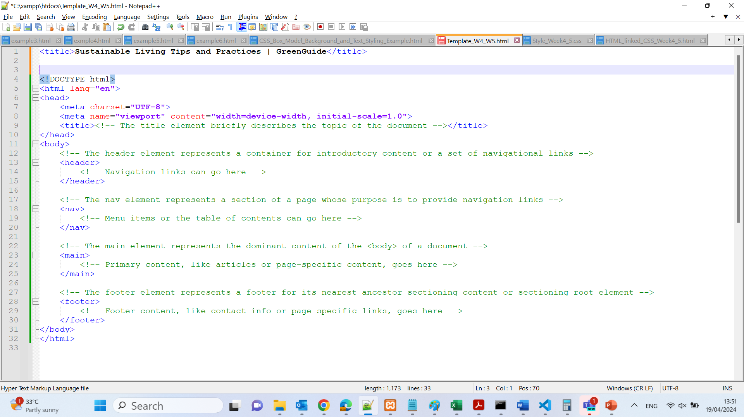
Choose Title for the HTML)
For instance:
If it’s a homepage for a business, you might use: "Brand Name - Leading Solutions in Industry".
If it’s an informational page about a specific topic, a title like "Complete Guide to Topic - Brand Name" could be appropriate.
Let's fill in the <title> tag with a placeholder based on a hypothetical topic. For example, if your site is about sustainable living, the title could be:
You can replace "Sustainable Living Tips and Practices | GreenGuide" with whatever fits your page content and purpose best!

Slide 28
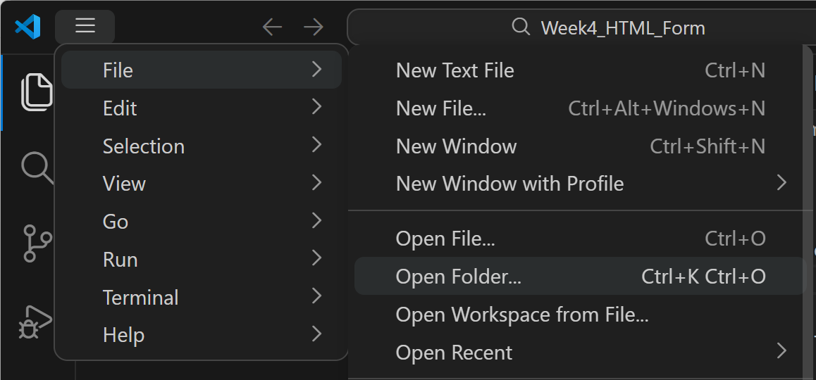
Create a folder and place all files (html and css) in the same folder
Go to Visual Studio Code and Open Folder
File >> Open Folder

Slide 29
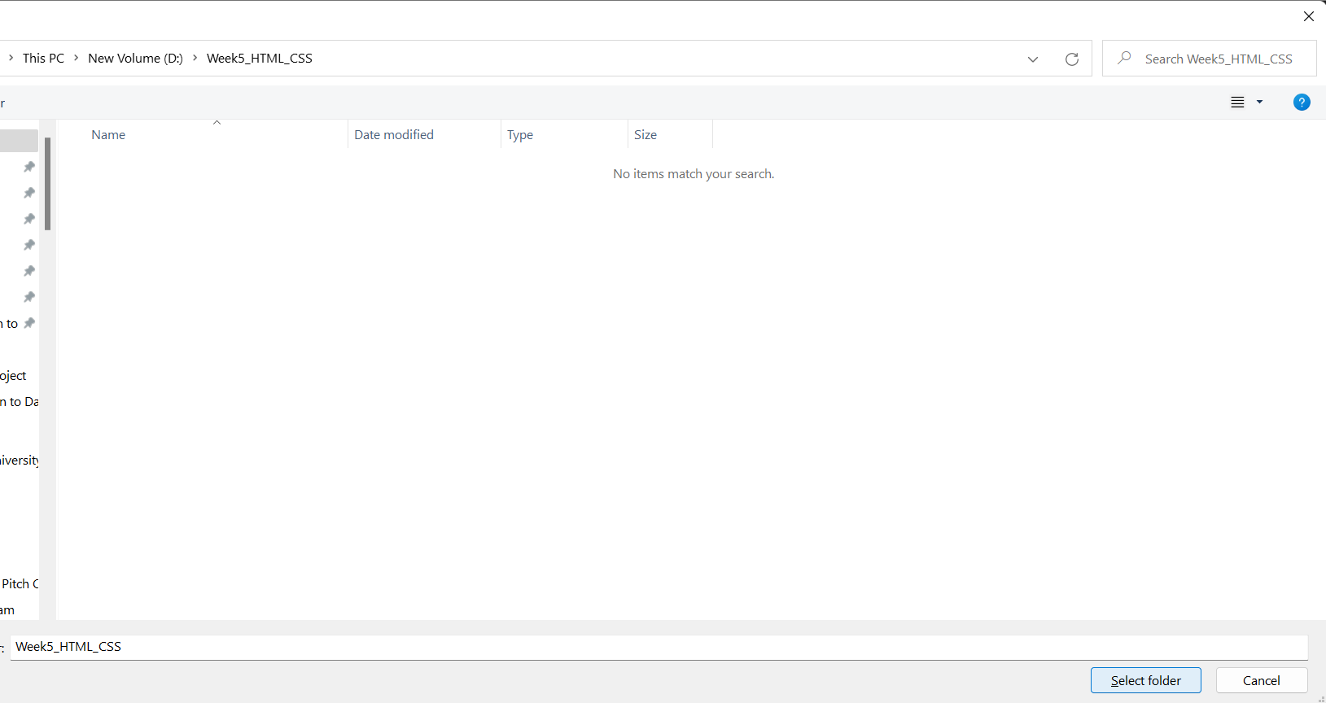
Double Click on the Folder >> Select folder

Slide 30
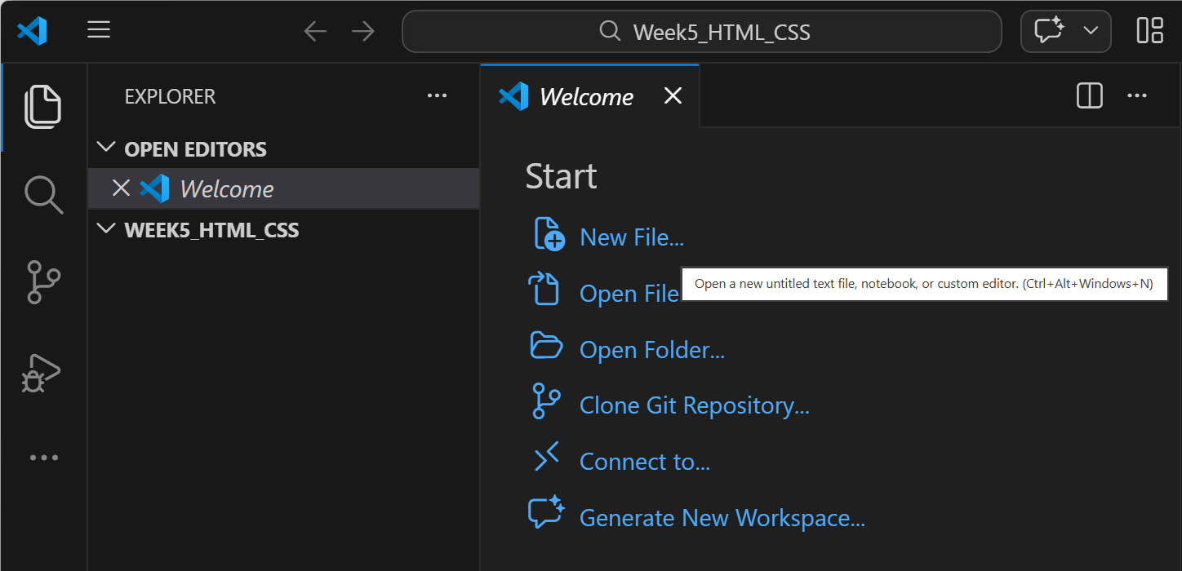

Slide 31
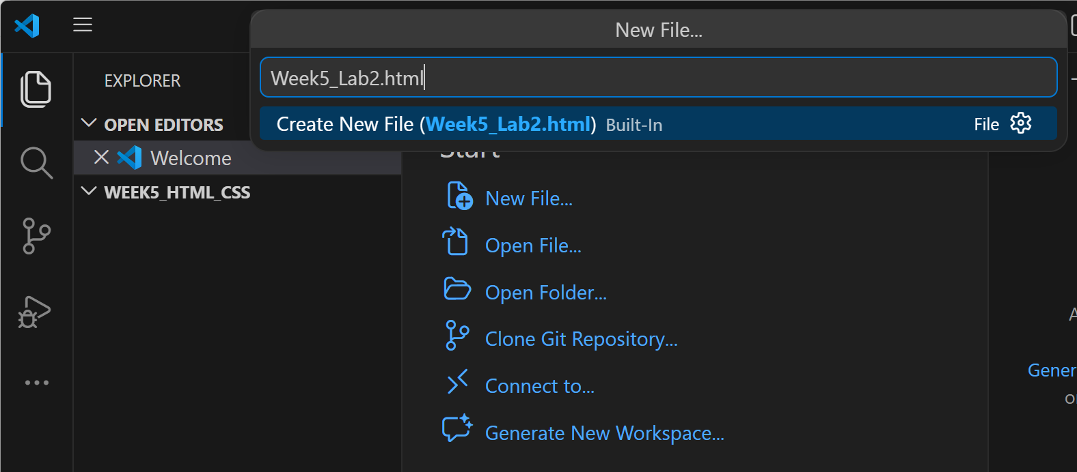
Choose a Name

Slide 32
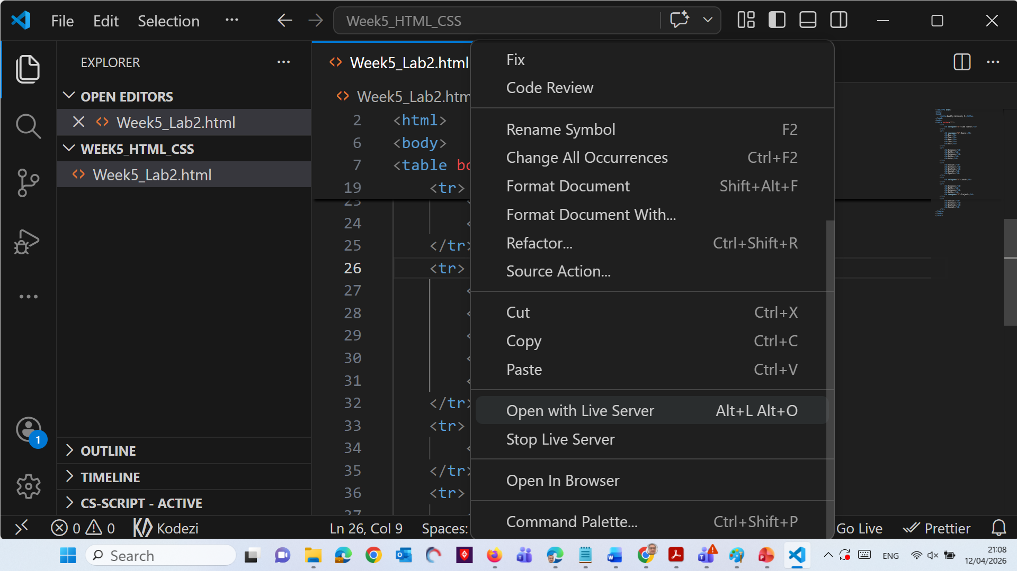
Once project finished
Right Click >> Open with Live Server

Slide 33
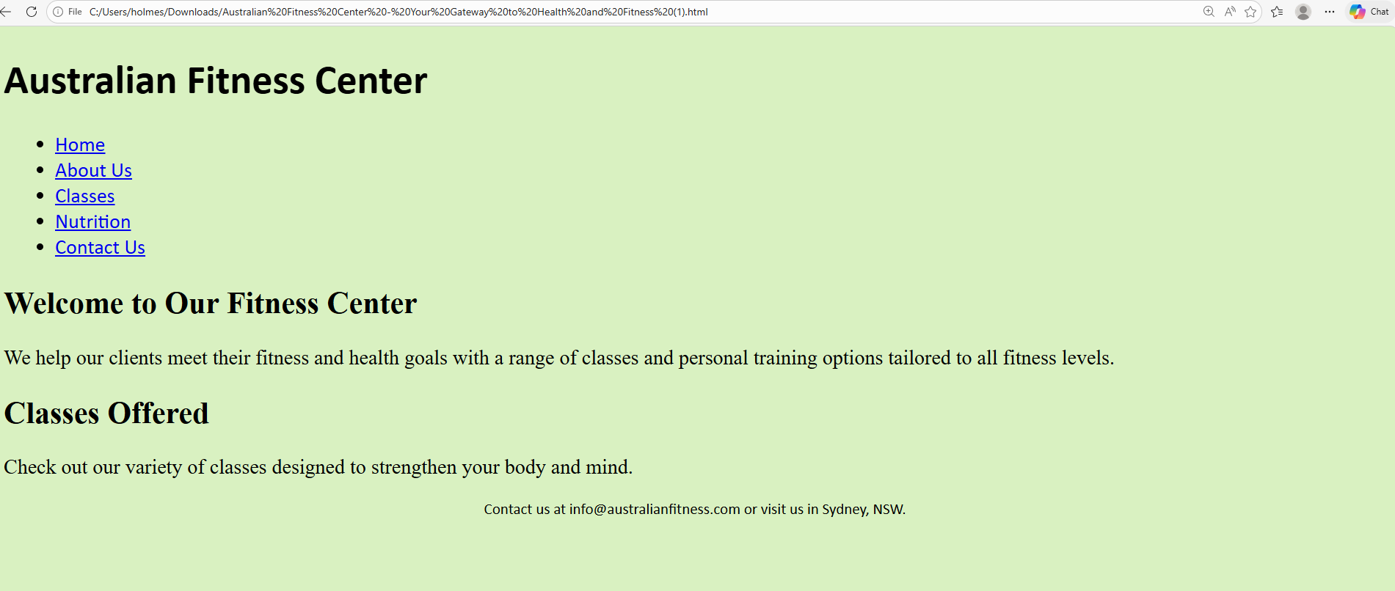

Slide 34
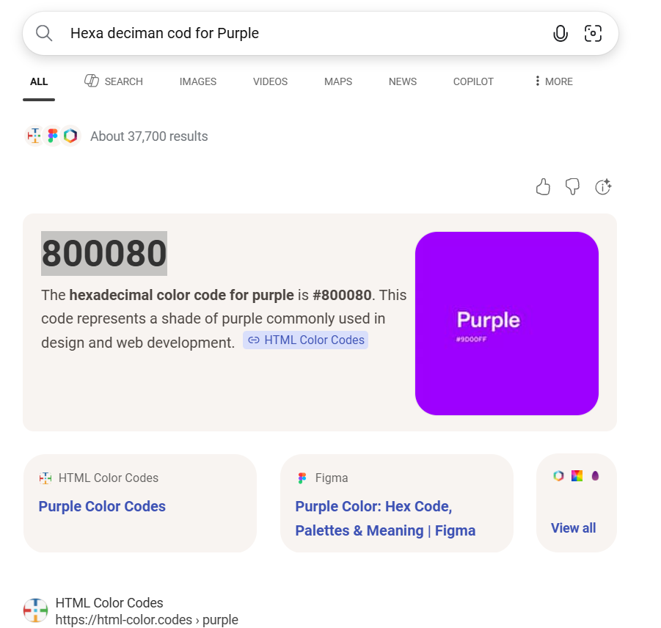
Change Background Color

Slide 35
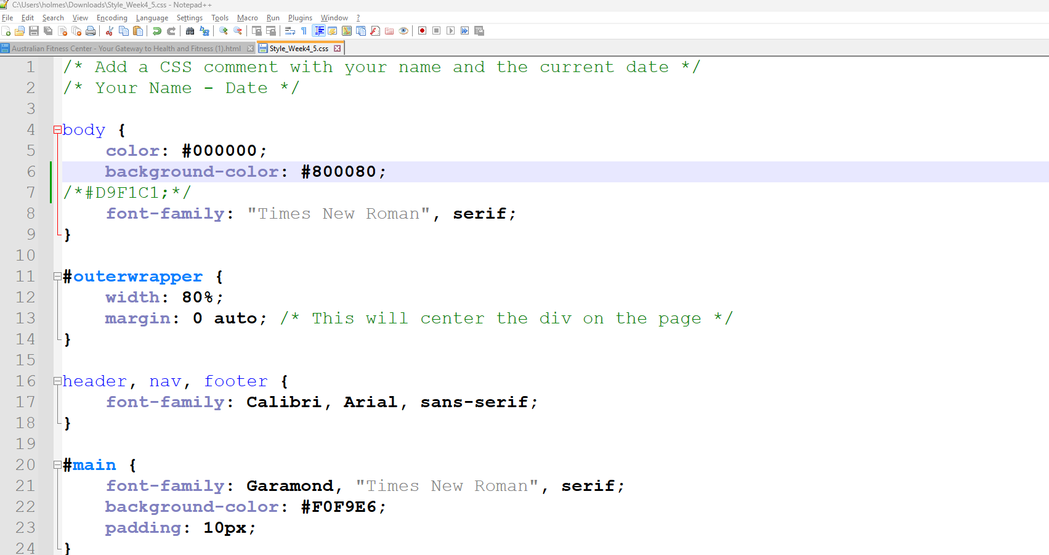
Change Background Color

Slide 36
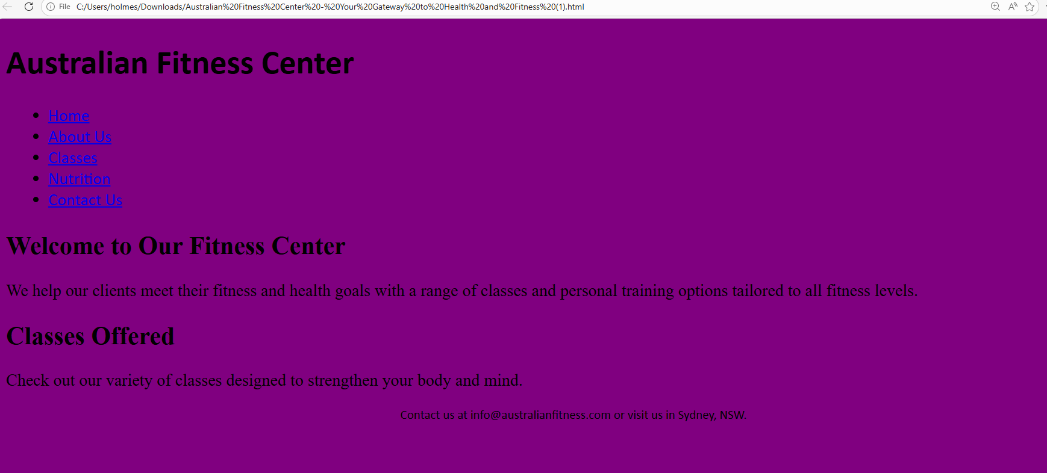
You will see this

Slide 37
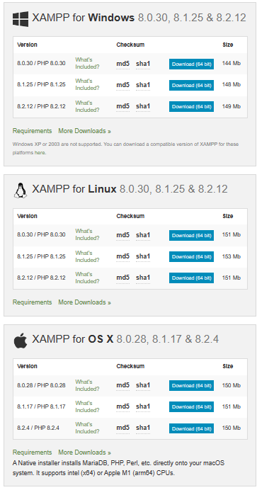
Creating A Web Saver Using Xampp or Aptana Studio
Install Xampp as the webserver on your systems and test it. https://www.apachefriends.org/de/download.html

Slide 38
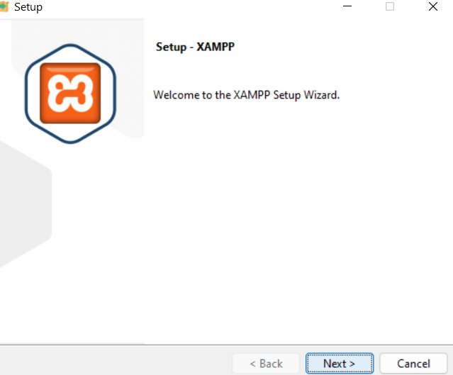

Slide 39
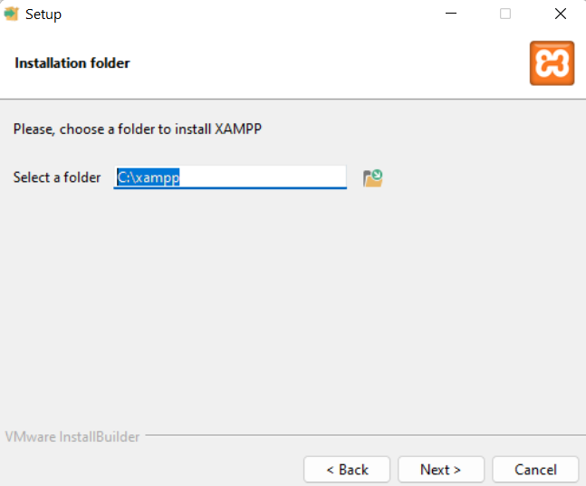
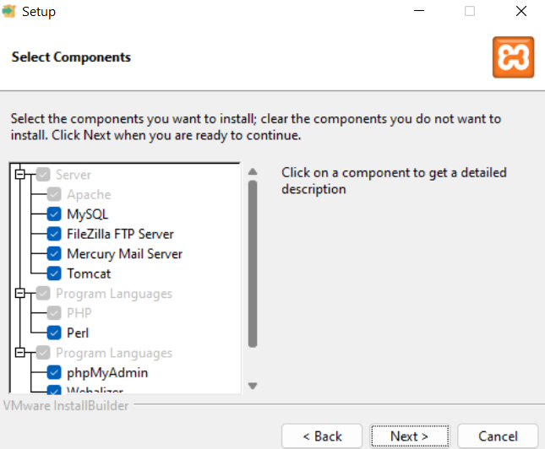

Slide 40
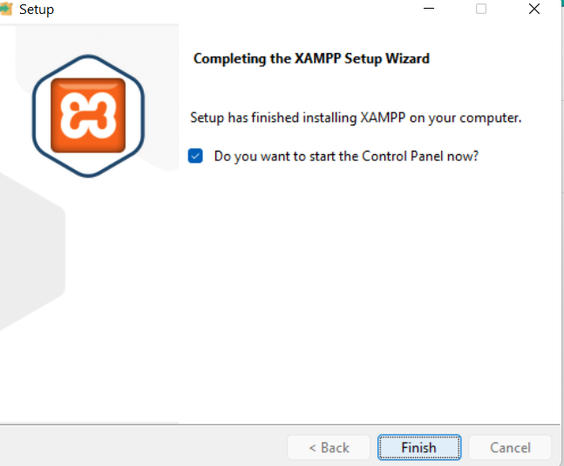

Slide 41
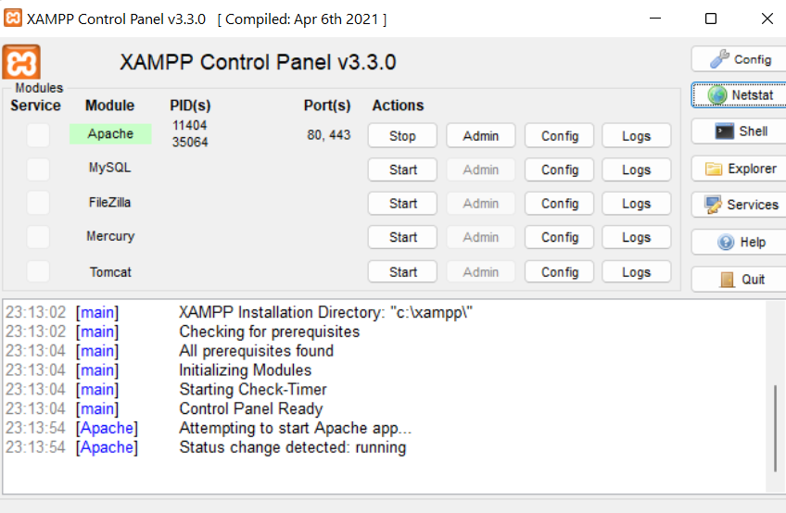

Slide 42
Weeks 4 - 5 Tutorial
The lecture 4 focuses on the essentials of using Cascading Style Sheets (CSS) for web design, emphasizing the separation of content from design to enhance flexibility and maintainability. The key topics covered include the definition and application of inline, embedded, and external stylesheets, each having its own order of precedence which determines how styles are applied when conflicts arise. The CSS box model is described in detail, showing how margins, borders, and padding are used to control layout and spacing. Practical elements such as floating images and styling lists were also discussed. Additionally, the lecture provided insights into using selectors for styling specific elements and the importance of validating CSS files to ensure they meet web standards.

Slide 43
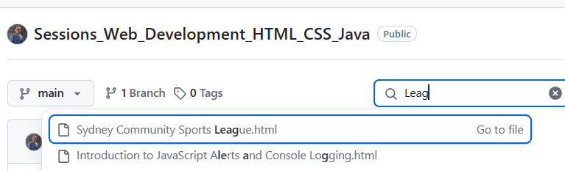
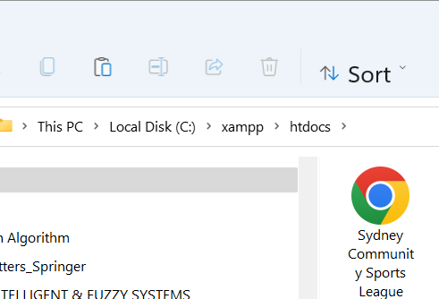
Practical Example: Creating a website for a community sports league in Sydney, Australia
Imagine a website for a community sports league in Sydney, Australia, which requires frequent updates and style changes to highlight different sports seasons. Using external stylesheets can make these updates more manageable. Below is a practical example of how CSS might be used in this context:
Change it and Save it in C:\\Xampp >> htdocs

Slide 44
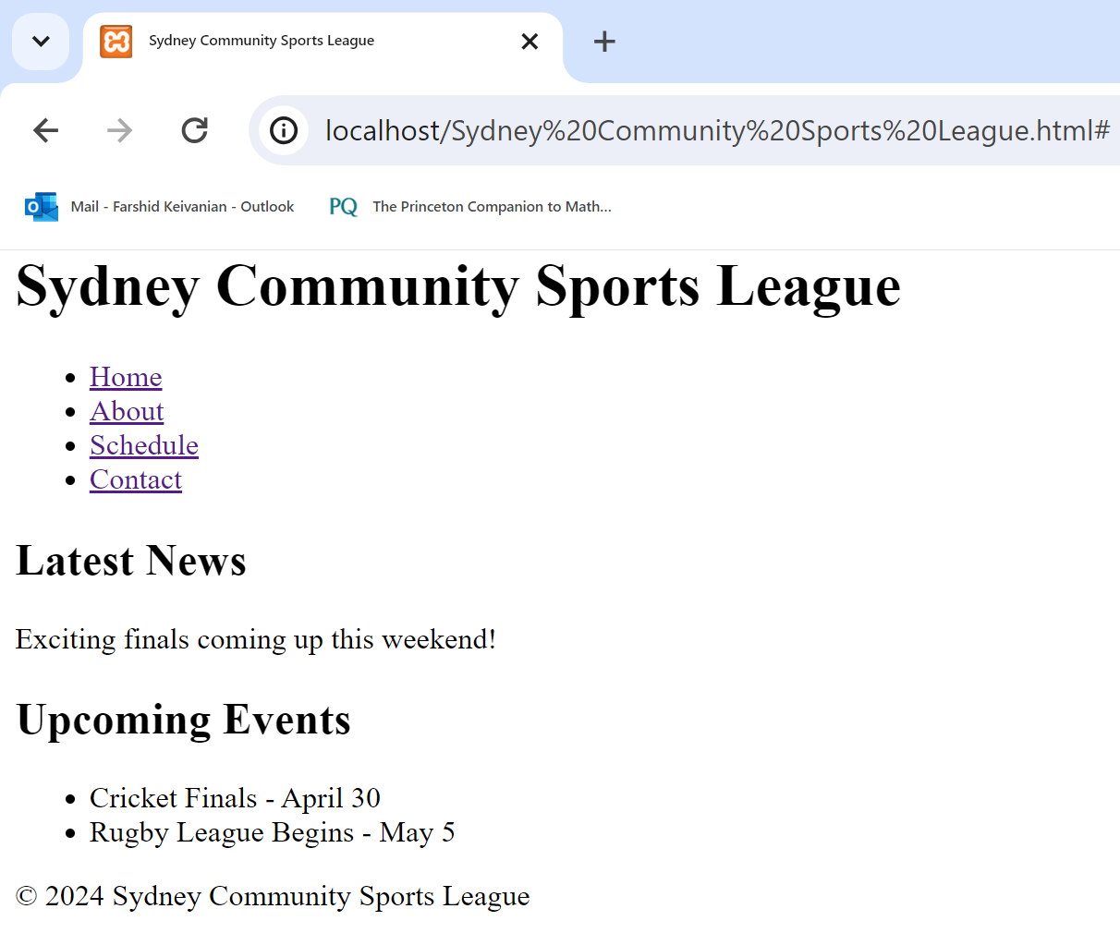
Practical Example: Creating a website for a community sports league in Sydney, Australia
The title used within the <title> tag of your HTML is "Sydney Community Sports League," which is a very good choice because it precisely describes the main content and purpose of the webpage. It aligns with the primary focus of the content which revolves around the sports league based in Sydney, and it helps with SEO (Search Engine Optimization) as well as user orientation when they see the title in their browser tab. Hence, this title is well-suited for the HTML document and adequately reflects its contents and primary function.

Slide 45
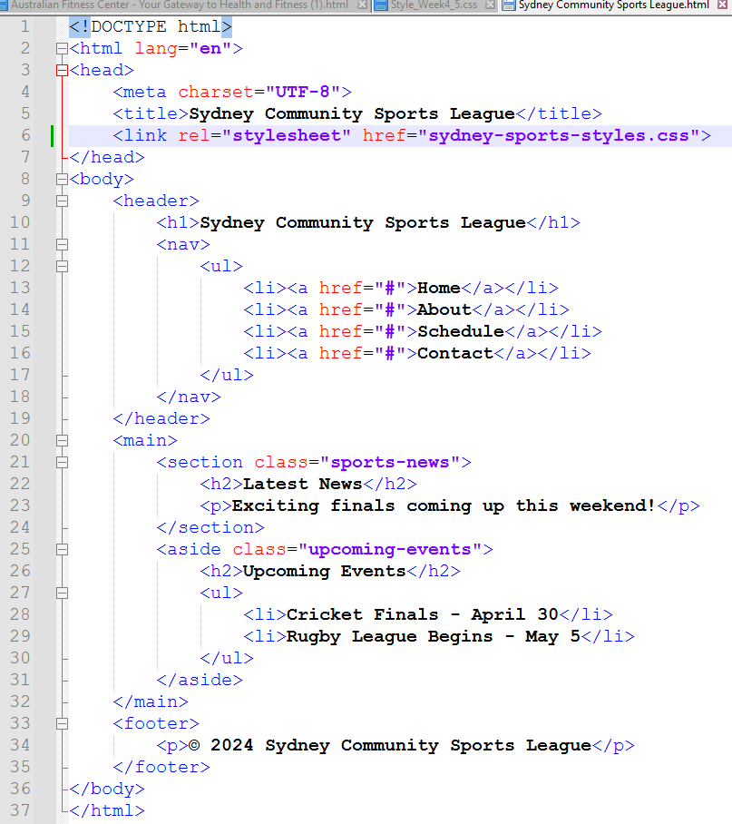
<!DOCTYPE html>: This declaration defines the document type and version of HTML. In this case, it specifies HTML5.
<html lang="en">: This is the root element of an HTML page, and lang="en" specifies that the content of the web page is in English.

Slide 46
<head>: This section contains metadata and links to external resources needed for the document. It doesn't display content on the web page itself.
<meta charset="UTF-8">: This tag specifies the character encoding for the HTML document, set to UTF-8, which includes most characters from all human languages.
<title>Sydney Community Sports League</title>: This sets the title of the web page, which appears in the browser tab.
<link rel="stylesheet" href="css/sydney-sports-styles.css">: This links an external CSS file that controls the styling of the webpage.

Slide 47
<body>: This section contains all the contents of the HTML document that are visible to the user.
<header>: This is the introductory content or navigational links for the page.
<h1>Sydney Community Sports League</h1>: The main heading of the page, displayed prominently.
<nav>: This element is intended for navigation links.
<ul>: An unordered list that contains navigation items.
<li><a href="#">...</a></li>: Each list item contains a hyperlink (<a>) that, in this example, doesn't lead anywhere (href="#").

Slide 48
<main>: The main content area of the document.
<section class="sports-news">: A section meant for grouping thematically related content, here identified by the class "sports-news".
<h2>Latest News</h2>: A heading for the section.
<p>Exciting finals coming up this weekend!</p>: A paragraph with some news content.

Slide 49
<aside class="upcoming-events">: This section is typically used for content tangentially related to the content around it (like sidebars), here identified by the class "upcoming-events".
<h2>Upcoming Events</h2>: Another heading, distinguishing this content's topic.
<ul>: Another unordered list detailing events.
<li>...</li>: List items with event details.
<footer>: This element typically contains information about the document, such as copyrights, links, or contact information.
<p>© 2024 Sydney Community Sports League</p>: A paragraph that provides copyright information.
This structure ensures that the webpage is well-organized and semantically meaningful, which helps with accessibility and SEO (Search Engine Optimization).

Slide 50
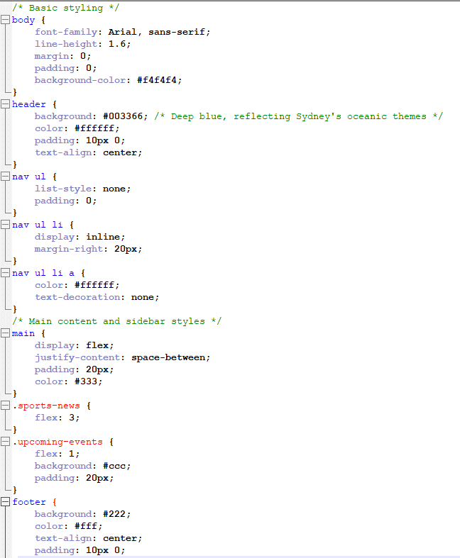
1. Body Styling: (Repository>>sydney-sports-styles.css)
Sets the font family to Arial with a fallback of any sans-serif typeface.
Line height is set to 1.6 for better readability.
Margin and padding are both set to 0 to remove default spacing.
The background color is a light grey (#f4f4f4).
2. Header Styling:
The background color is a deep blue (#003366), likely chosen to reflect an oceanic theme, possibly linked to Sydney.
Text color is white (#ffffff).
Padding is 10 pixels on the top and bottom.
Text alignment is centered.

Slide 51
3. Navigation Menu:
The ul element has no list style and no padding to create a clean horizontal navigation bar.
li elements are displayed inline and have a 20-pixel margin on the right to space out the links.
The links (a elements) within the li have white text and no text decoration to maintain a clean and readable navigation bar.

Slide 52
4. Main Content and Sidebar Styles:
The main element uses a flexible box layout (display: flex) to organize content within it, spacing out children elements using justify-content: space-between.
Padding is 20 pixels.
Text color inside the main element is a dark grey (#333).
The .sports-news class takes up 3 parts of the available space (flex: 3), making it the primary content area.
The .upcoming-events class takes up 1 part of the available space (flex: 1), serves as a sidebar, and has a light grey background (#ccc) with 20 pixels of padding.

Slide 53
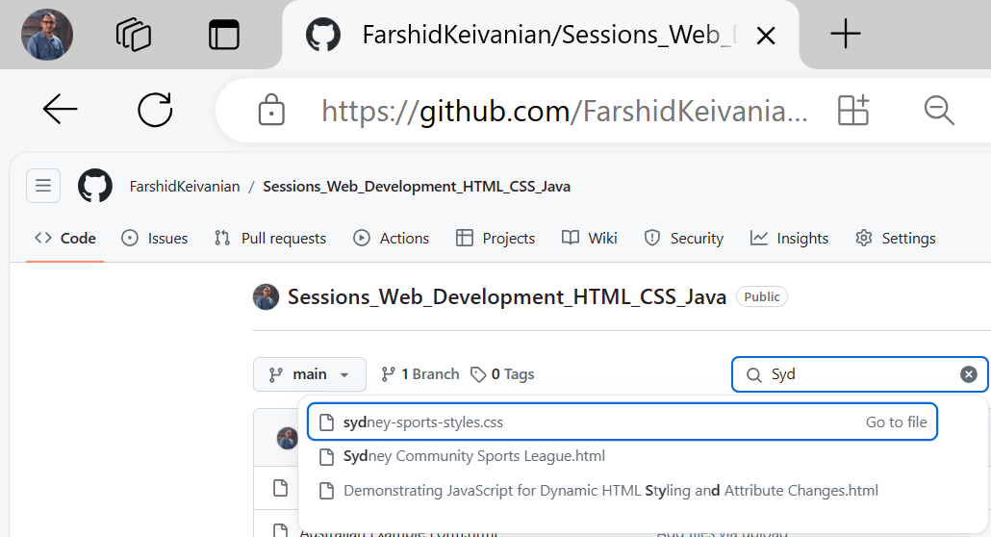
5. Footer Styling:
Background color is dark grey (#222).
Text color is white (#ffffff).
Text is centered.
Padding is 10 pixels on the top and bottom.
This setup ensures a visually balanced page with a clear distinction between different sections, such as the header, navigation, main content, sidebar, and footer.

Slide 54
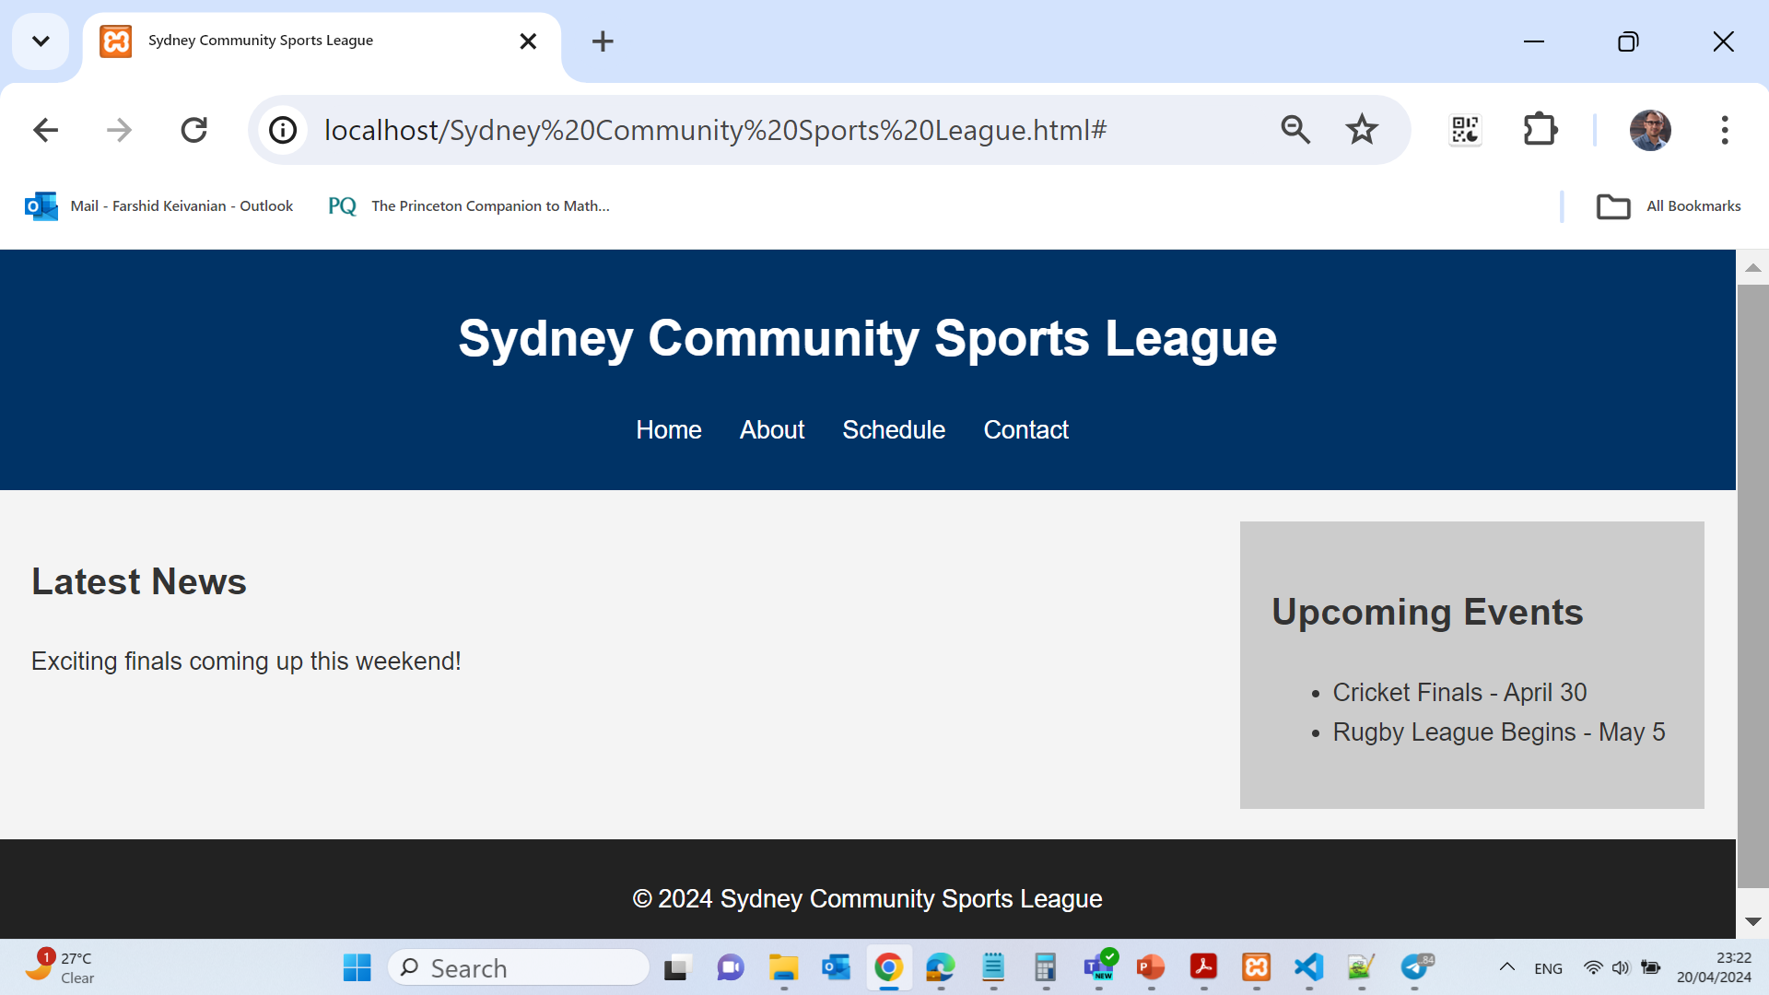
HTML
HTML & CSS

Slide 55
9 Essential SEO Practices for Optimizing Title Tags
The article from Search Engine Land discusses nine best practices for optimizing the <title> tags of webpages to enhance their SEO effectiveness. http://searchengineland.com/nine-best-practices-for-optimized-title-tags-111979
Single Use Per Page: There should only be one <title> tag per page, positioned within the <head> tag to ensure valid HTML and to maximize its SEO value.
Keyword Placement: Place your most important keywords at the beginning of the <title> tag, as search engines assign the highest value to the first few words.

Slide 56
9 Essential SEO Practices for Optimizing Title Tags
3. Include Branding at the End: If branding is less crucial than specific keywords, it should be placed at the end of the <title> tag to maintain keyword prominence.
4. Character Limit: Keep <title> tags under 70 characters to prevent truncation in search engine results pages (SERPs), ensuring all characters carry potential SEO benefit.
5. Avoid Stop Words: Minimize the use of stop words (like "and", "or", "but") that do not contribute to SEO, to keep the focus on more impactful keywords.
6. Reflect Body Text Keywords: Ensure the keywords in the <title> tag align with those used in the page’s body text, reinforcing the content’s theme for search engines.

Slide 57
9 Essential SEO Practices for Optimizing Title Tags
7. Uniqueness Across Pages: Each page should have a unique <title> tag to avoid duplicate content issues and to accurately reflect the page’s content.
8. Avoid Duplication with <h1> Tags: The text in <title> tags should not simply repeat what’s in the <h1> tag, to optimize the use of different keywords.
9. No Keyword Stuffing: Overusing keywords in the <title> tag can be seen as spammy by search engines, potentially leading to penalties.
The article emphasizes the importance of crafting <title> tags thoughtfully to improve both search engine visibility and user engagement. These practices can significantly influence how webpages are perceived by search engines and by people browsing search results.

Slide 58
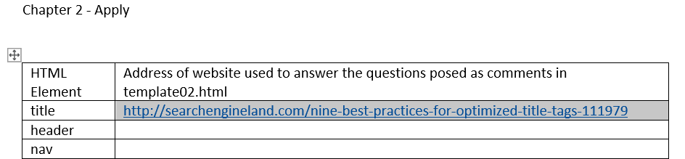
Project 1: Creating a Template with a Semantic Wireframe
For step 5, you would copy the addresses of the websites you used to research the title element and paste them into the table provided in the Word document.

Slide 59
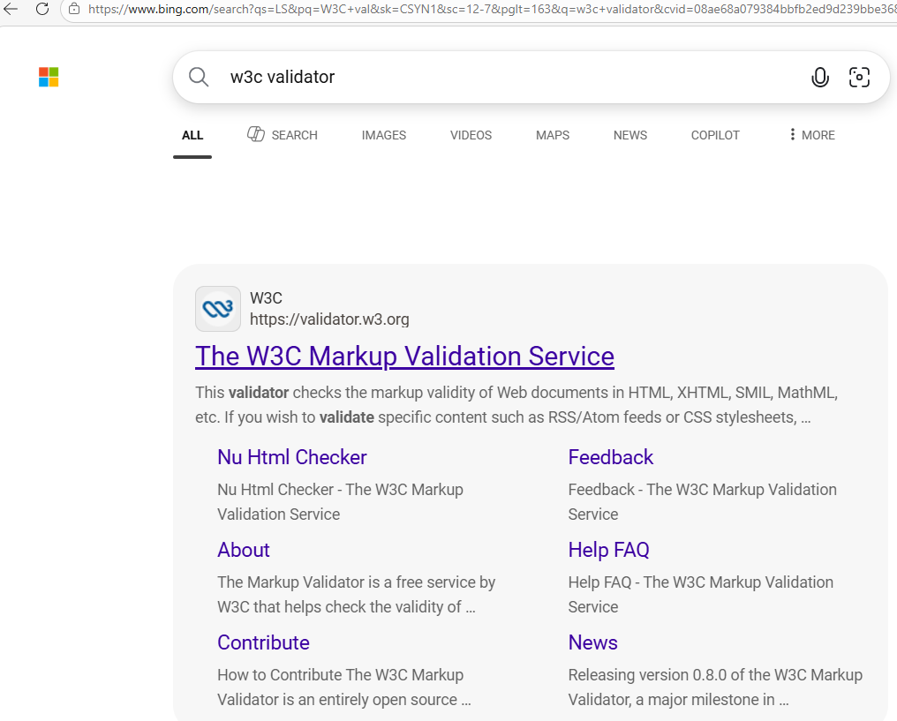
Project 1: Creating a Template with a Semantic Wireframe
In Google, search for w3c validator

Slide 60
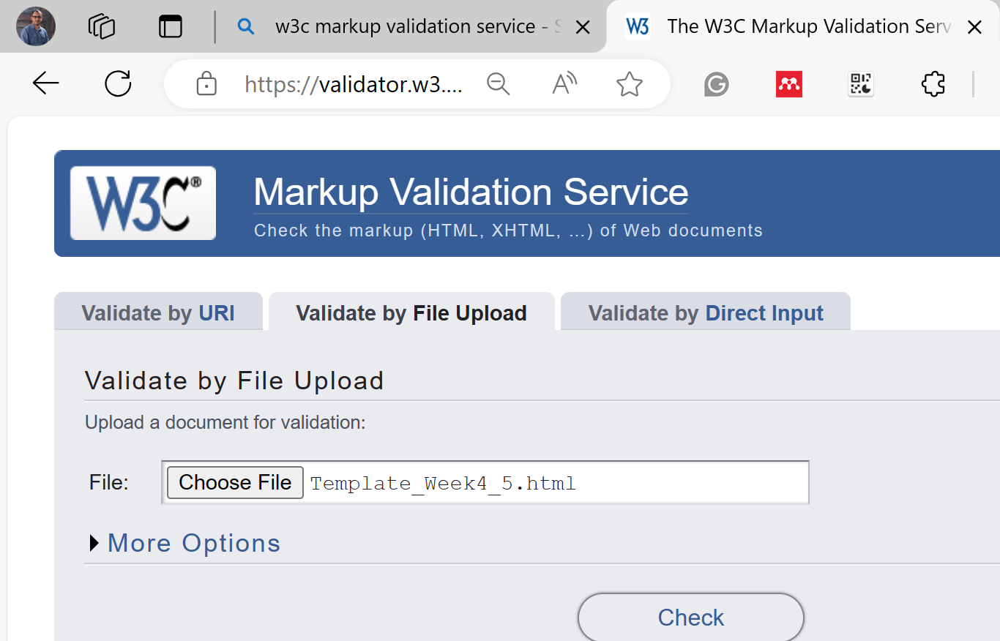
Project 1: Creating a Template with a Semantic Wireframe
For steps 9 and 10, we'll need to validate our HTML using the W3C validator and conduct further research on semantic HTML. Here are the answers for steps 10a-d:
a. Semantic HTML: Semantic HTML or semantic markup is HTML that introduces meaning to the web page rather than just presentation. For example, a <p> tag indicates that the enclosed text is a paragraph. This is both semantic and presentational because people know what paragraphs are, and browsers know how to display them.

Slide 61
Project 1: Creating a Template with a Semantic Wireframe
b. Benefits of Semantic HTML: Semantic HTML leads to better accessibility, greater visibility to search engines, more flexible and maintainable code, and it can also aid in the development of better user interfaces.
c. New HTML5 Semantic Elements: Some of the new HTML5 semantic elements include <article>, <aside>, <details>, <figcaption>, <figure>, <footer>, <header>, <main>, <mark>, <nav>, <section>, <summary>, and <time>.

Slide 62
Project 1: Creating a Template with a Semantic Wireframe
d. <main> vs. <div id="main">:
Primary advantage: The <main> element is more semantically meaningful than <div>. It conveys to the browser, developers, and assistive technologies that this is the main content area of the page.
Primary disadvantage: The <main> element is not supported in Internet Explorer 11 and older versions, whereas a <div> with an ID is supported across all browsers.
Remember to cite the websites where you found these answers in your apply02.docx document, as per project instructions.

Slide 63
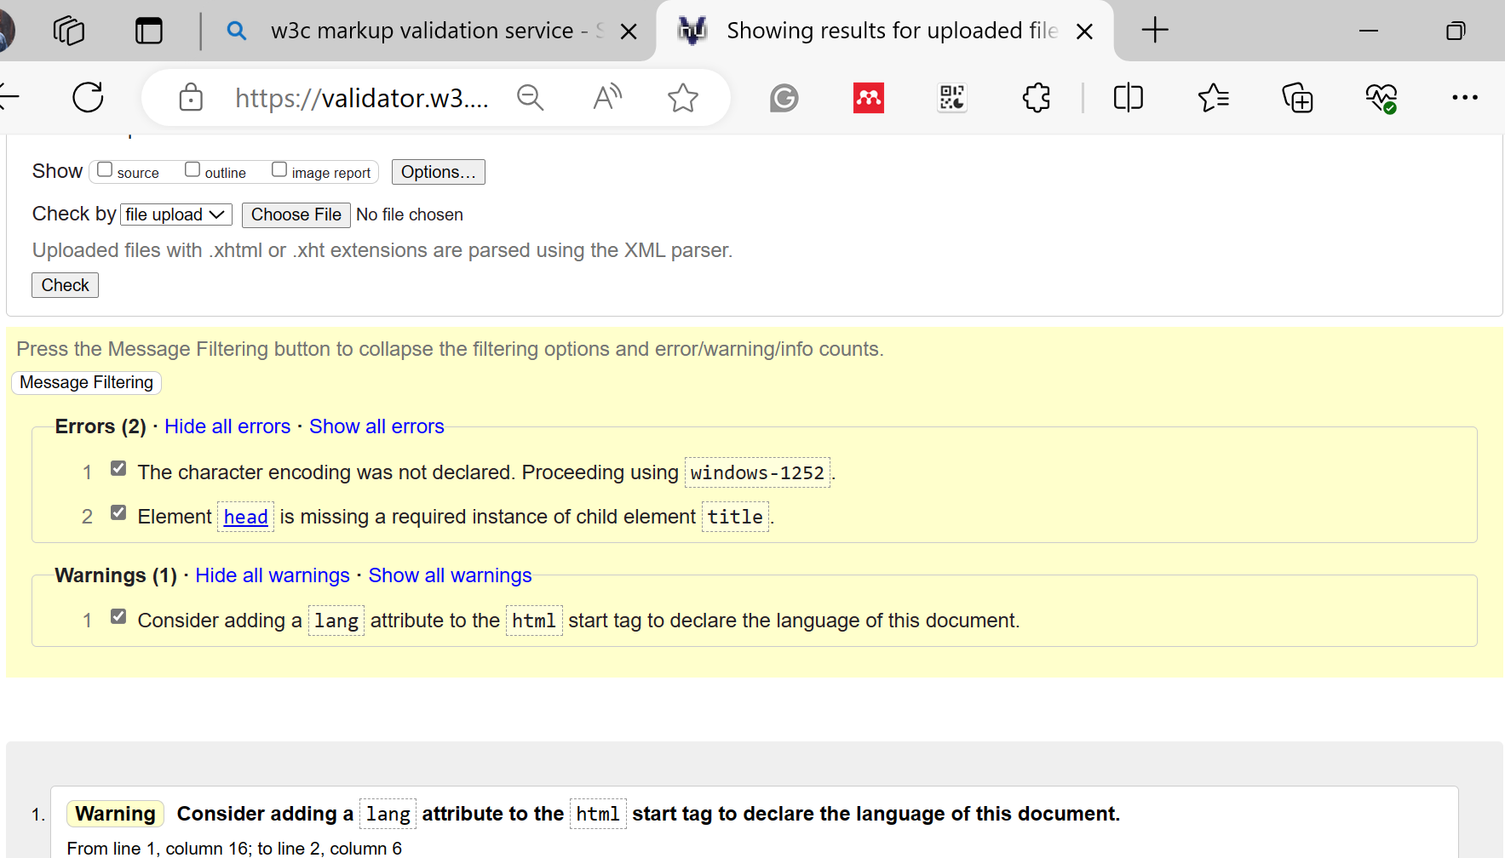
Project 1: Creating a Template with a Semantic Wireframe

Slide 64
Project 1: Creating a Template with a Semantic Wireframe
1. Language Attribute Warning: The warning suggests that a lang attribute should be added to the html tag to declare the language of the document. It seems we've already addressed this issue in our code by adding lang="en" to the html tag.
2. Character Encoding Declaration: This error indicates that the character encoding wasn't declared. However, looking at our provided code, <meta charset="UTF-8"> in the head tag, which correctly declares the character encoding.
3. Missing Title Content: The error reports that the title tag is present but missing actual text content. The title tag in our code is empty and only contains a comment placeholder.
To fix these issues based on your current code, you should provide actual text content within the title tag. Here's how we can modify the relevant part of our template code:

Slide 65
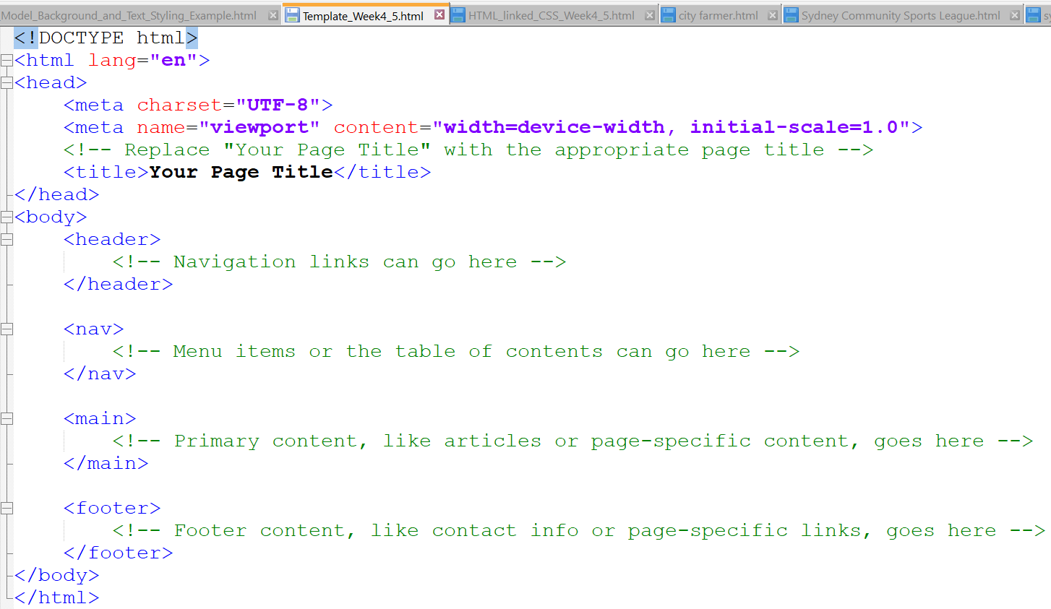
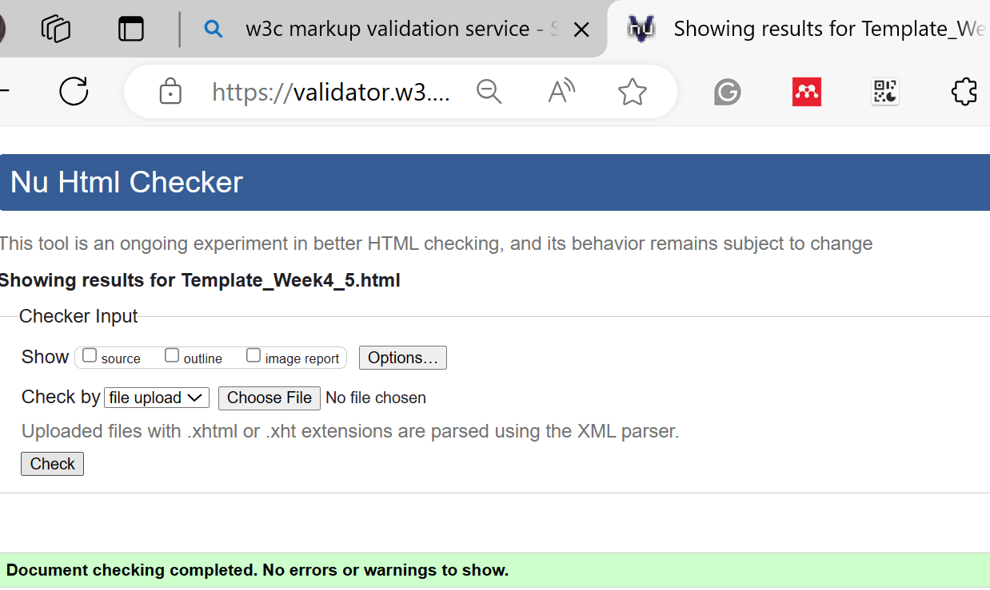
Project 1: Creating a Template with a Semantic Wireframe
In this correction, we've replaced the comment within the title tag with "Your Page Title". We should replace "Your Page Title" with the actual title of our webpage, which briefly describes the topic or purpose of the document. This should clear the error regarding the missing title content. All other elements seem to be appropriately addressed in your code.

Slide 66
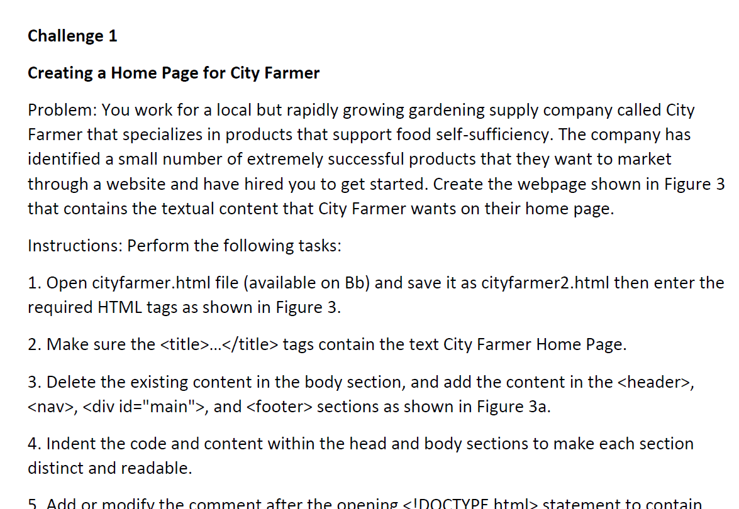
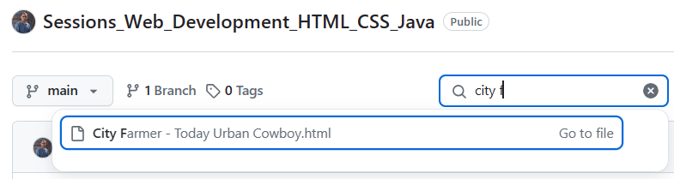
Challenge 1
Open cityfarmer.html, save as cityfarmer2.html. Here's the template for how the HTML file might look after you open it and make the necessary changes.
You might choose this title City Farmer: Today's Urban Cowboy which captures the essence of the content and theme presented in the HTML, linking the main focus of the webpage—urban farming—with a catchy and memorable phrase, "today's urban cowboy," which also appears in the header of the HTML. This title would be effective for both search engine optimization (SEO) and giving visitors a clear idea of the website's theme at first glance.

Slide 67
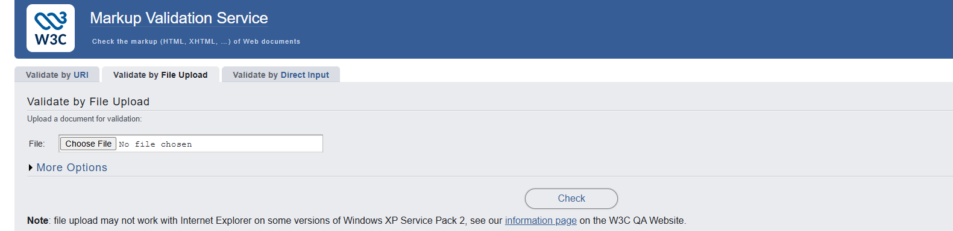

Slide 68
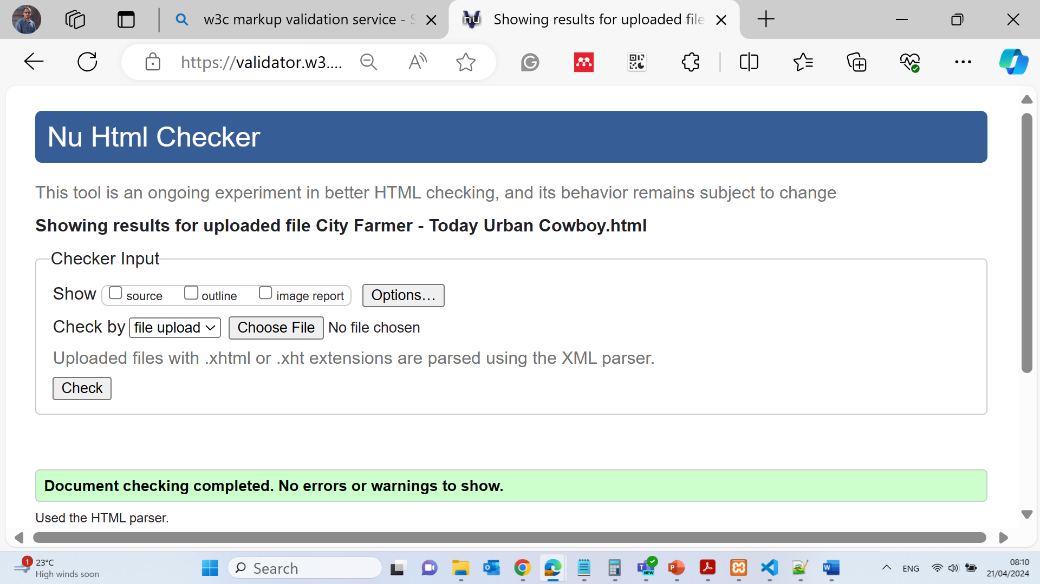
2. The title tag is included above within the <head> tags.
3. The existing content within the <body> tag has been replaced with the new content as per your instructions.
4. Code indentation has been handled for readability.
5. Comment after <!DOCTYPE html> has been added to include your name and the current date.
6. To validate your code, you would use a service like the W3C Markup Validation Service. https://validator.w3.org/
7. Ensure that the spelling of the text in your actual code matches that shown in the figure.
8. To view your HTML file in a browser, you would open the saved cityfarmer2.html file in any web browser to see the result.

Slide 69
Now for the second part of your question, the benefits of entering the wireframe HTML elements such as <header>, <nav>, <div id="main">, and <footer> before entering the textual content are as follows:
What are the benefits of entering the wireframe HTML elements such as header, nav, <div id="main">, and footer before entering the textual content for the webpage?
It helps establish the basic structure of the page before you get into the details.
It allows you to visualize the layout and ensure that all parts of the page are accounted for.
It can help with organization and planning, especially if multiple people are working on the content and design.
It allows you to style these elements with CSS simultaneously while adding content, making the development process more efficient.
It's easier to troubleshoot and debug the structure before content is added, as errors can be more readily identified and fixed.

Slide 70
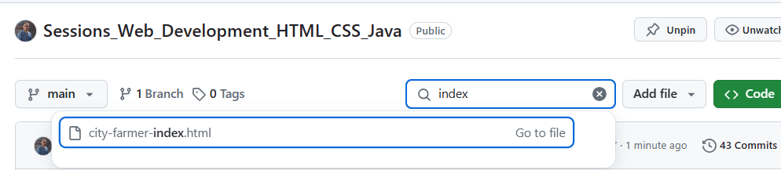
Challenge 2 - Creating an External Style Sheet for City Farmer
To complete Challenge 2 as outlined in the task description, you'll need to create an external stylesheet and update the HTML file with the specified changes. Below are the step-by-step instructions to complete this challenge.
First, here is the updated HTML code, saved as cityfarmer04.html, with the modifications as instructed, including comments with your name and today's date (the date has been left generic for you to fill in). Note that the image tags will be updated in step 13:
‘Index’ or ‘home’ file names are common for the main page

Slide 71
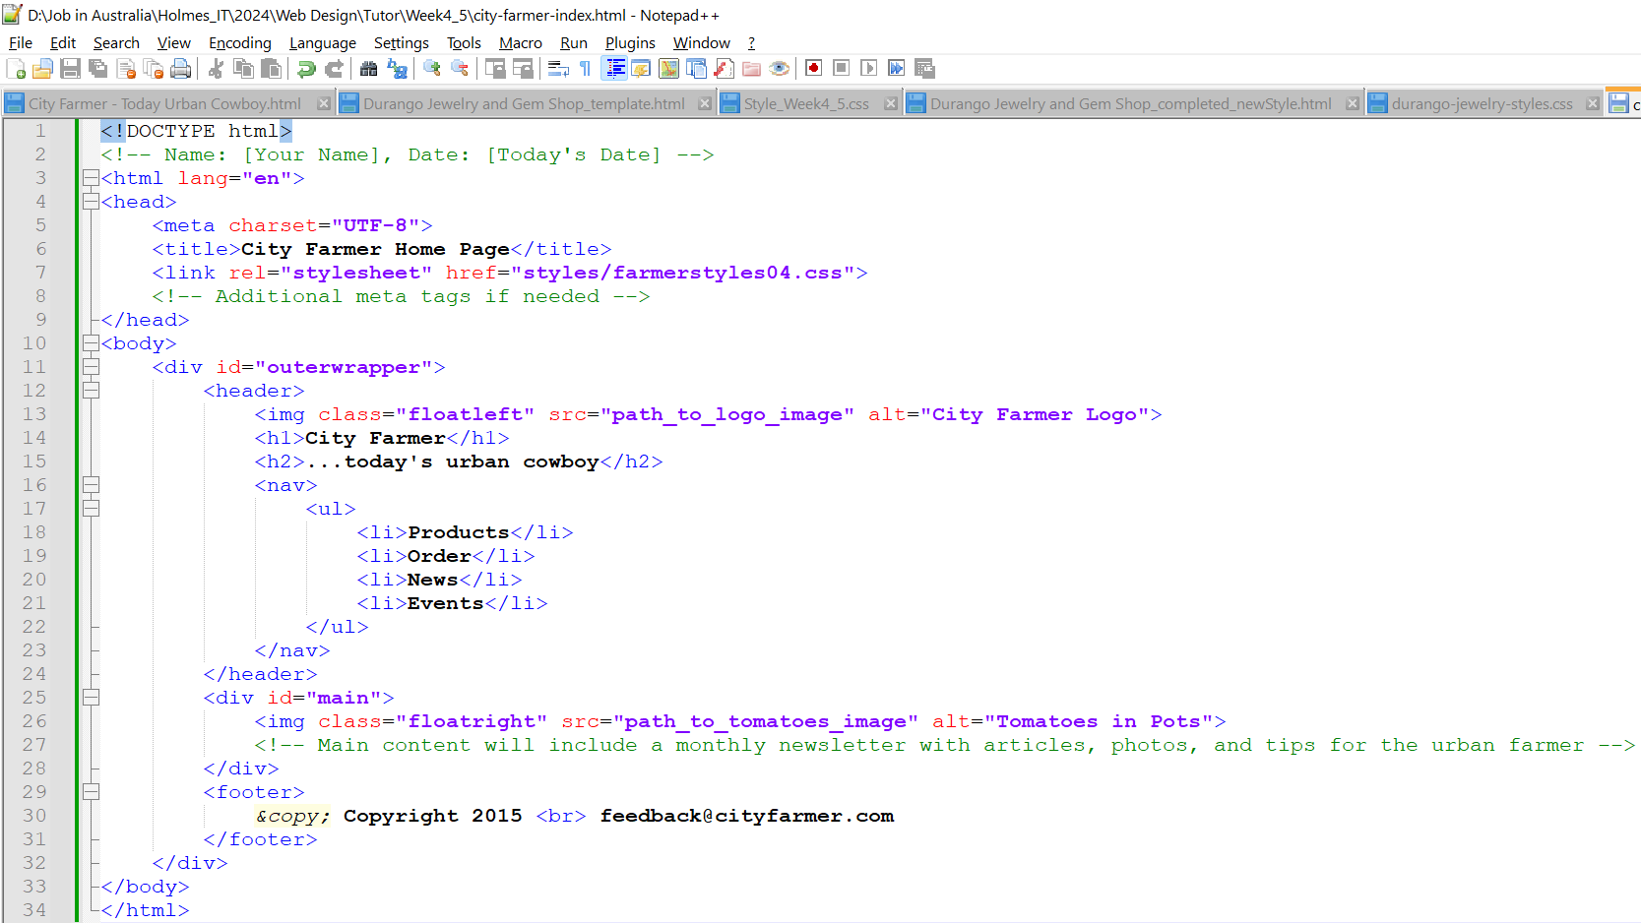
Challenge 2 - Creating an External Style Sheet for City Farmer
This HTML code is available on Github
City-Farmer-Index.HTML
“City-Farmer-Style.css”>

Slide 72
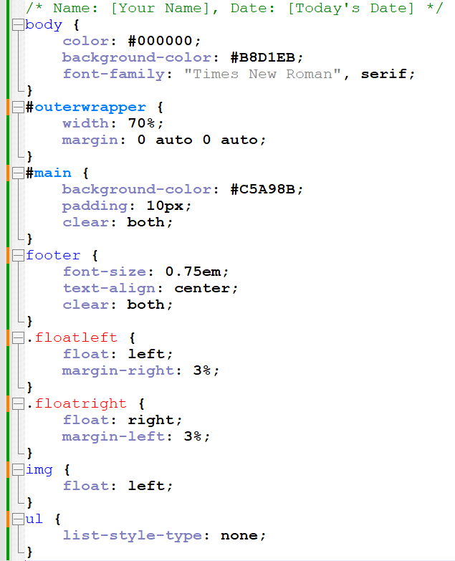
Challenge 2 - Creating an External Style Sheet for City Farmer
Regarding step 19, using classes like class="floatleft" and class="floatright" instead of IDs is considered a better practice when the styles are not unique and may be reused. Classes allow for the same styling to be applied to multiple elements, whereas IDs are intended to be unique within the page. This means if you want to float another image to the right or left, you can simply apply the same class without duplicating the style rules. Classes are generally more flexible and can help keep your stylesheets cleaner and more manageable.
Use Notepad ++ and type this code, then save it as Cascade Style Sheets File
City-Farmer-Style.CSS

Slide 73
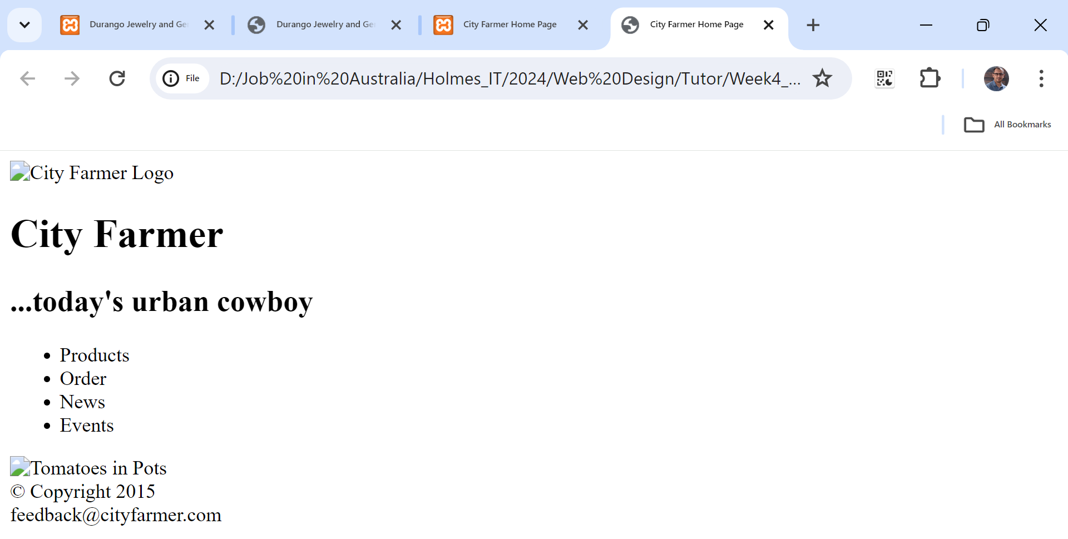
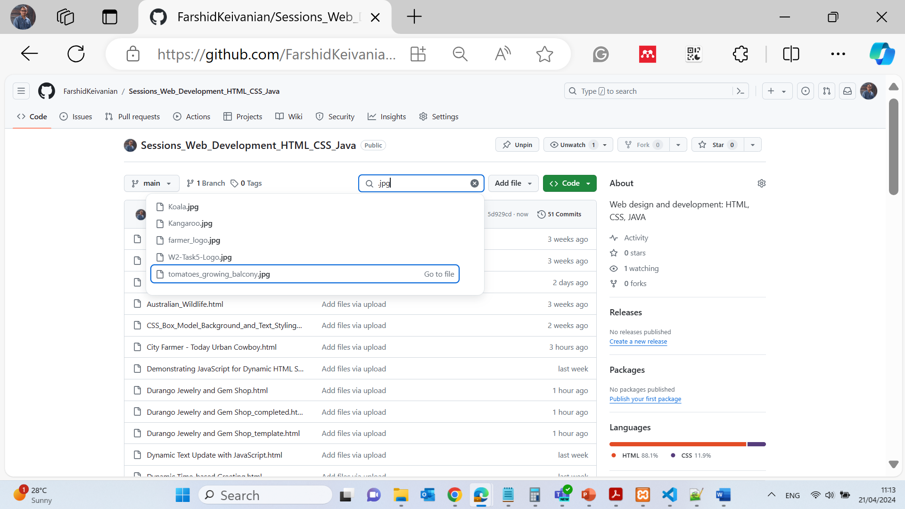
Challenge 2 - Creating an External Style Sheet for City Farmer
Download the jpg file from GitHub

Slide 74


Sidebar Project:
This code creates a layout with a sidebar and a main content area side by side using flexbox. The logo and menu are in the sidebar, and the title and subtitle are in the main content area. Adjust the values of flex-basis, margin, padding, and other properties as necessary to fit the specific design you're aiming for.

Slide 75

flex-basis: 250px;: This sets the default size of the sidebar. When using a flexbox layout, flex-basis is used to define the ideal size of a flex item before it's adjusted by flex-grow or flex-shrink. Here, it means that the sidebar will try to be 250 pixels wide.
background-color: #f0f0f0;: This sets the background color of the sidebar. The color #f0f0f0 is a very light grey, providing a subtle contrast with other elements.
padding: 20px;: This adds space inside the sidebar, between the border of the sidebar and its content. This means all the content inside the sidebar will have a 20-pixel space from its edges.

Slide 76
This CSS class is a part of the flexbox layout defined by the display: flex; property in the body rule. The sidebar will be a flex item alongside any other flex items within the body. In this layout, the sidebar will have a fixed starting width of 250 pixels and will contain whatever content is designated within the sidebar division in the HTML, such as a logo and a navigation menu. The padding inside ensures that this content is not flush against the sides of the sidebar, providing a nicer visual presentation.

Slide 77



Slide 78


Slide 79


Slide 80

Project 2 – Styling a Webpage
This project outlines a common task in web development which is creating a responsive and well-styled webpage. We explore the necessary HTML and CSS code according to the instructions provided in project 2.
Use Notepad++ or Visual Studio or online platform https://w3schools.com/ as for your text editor

Slide 81


Project 2 – Styling a Webpage
For Steps 15, 16, 17, and 18: We would manually wrap the text "Smoky quartz" and "Soulmate Crystal" in <span> tags with inline styles, validate our HTML and CSS using the W3C validators, and adjust our CSS formatting to be clean and professional.

Slide 82


Validate our HTML and CSS using the W3C validators and adjust our CSS formatting to be clean and professional.
Step 19: You will submit the html and css files.

Slide 83
Step 20a: Comments like <!--close the outerwrapper--> are especially useful for clarifying which <div> tag is being closed, as <div> elements often nest within each other and it can be challenging to track them without comments.
Step 20b: The primary advantage of using an external stylesheet is maintainability and reusability. You can apply the same styles across multiple pages which makes it easier to keep a consistent look throughout a site, and if you need to make a change, you can do it in one place rather than editing each page individually.
Step 20c: Inline styles are useful for one-off style changes that don't merit a class by themselves or to override other styles. However, they can become hard to manage in large documents, hence they're typically used sparingly.

Slide 84


Project 2: Styling a Webpage
The title ‘Durango Jewelry and Gem Shop’ is clear and descriptive
HTML

Slide 85

Project 2: Styling a Webpage
HTML completed!
We need to change the style file

Slide 86

Project 2: Styling a Webpage
In the HTML file, you should replace [Your Name] with your name, [Today's Date] with the current date, and [email] with the actual contact email. The image source image.jpg should be the path to the image provided. In the CSS file, replace #DAE5D0 with the actual background color you desire, and adjust other styles as needed to match the design you're aiming for.

Slide 87


Slide 88


Styling a Webpage

Slide 89

Styling a Webpage

Slide 90
Lab 2 Test (Week 4 & 5)
Question 1
What is the filename you must save your template as in Project 1?
A. template02.html B. template01.html C. wireframe.html D. mainpage.html
A. template02.html
The project instructions say the template file must be saved as template02.html so the correct file can be identified and submitted.

Slide 91
Lab 2 Test (Week 4 & 5)
Question 2
What HTML element contains the comment questions you must replace with research answers?
A. title B. body C. div D. footer
The title element contains the comment questions that need to be replaced with research answers.

Slide 92
Lab 2 Test (Week 4 & 5)
Question 3
Where should the research website addresses be recorded?
A. apply02.docx B. webpublishing.docx C. portfolio.docx D. wireframe02.docx
All website links and research references must be saved in apply02.docx.

Slide 93
Lab 2 Test (Week 4 & 5)
Question 4
Which semantic element is not listed as part of the wireframe to be researched?
A. header B. aside
C. nav D. main
The wireframe research includes header, nav, and main, but not aside.

Slide 94
Lab 2 Test (Week 4 & 5)
Question 5
What message must the W3C validator show after successful validation?
A. No warnings found B. Validation passed C. This document was successfully checked as HTML5! D. HTML verified
This message confirms that the HTML code is correct and follows HTML5 standards.

Slide 95
Lab 2 Test (Week 4 & 5)
Question 6
What is the definition the lab asks you to research in step 10(a)?
A. responsive HTML B. structural CSS C. inline elements
D. semantic HTML
Semantic HTML uses meaningful tags like <header> and <footer> to organise webpage content clearly.

Slide 96
Lab 2 Test (Week 4 & 5)
Question 7
Which City Farmer file must you open and resave for Challenge 1?
A. index.html B. apply02.html
C. cityfarmer.html D. template02.html
The task instructions require opening and saving the file cityfarmer.html.

Slide 97
Lab 2 Test (Week 4 & 5)
Question 8
What text must be placed inside the element for City Farmer pages?
A. City Farmer Home Page B. City Farmer Website C. City Farmer Products D. City Farmer Main
This text is used as the heading or title for the City Farmer homepage.

Slide 98
Lab 2 Test (Week 4 & 5)
Question 9
Which sections must be added to cityfarmer2.html in Challenge 1?
A. header, aside, article, footer B. header, nav, div id="main", footer
C. header, body, main, aside D. nav, article, footer, section
These sections organise the webpage into header, navigation, main content, and footer areas.

Slide 99
Lab 2 Test (Week 4 & 5)
Question 10
What must you add after the opening in City Farmer pages?
A. A comment with your name and the current date B. A title tag C. A CSS link D. A JavaScript tag
The comment shows who edited the page and when it was updated.

Slide 100
Lab 2 Test (Week 4 & 5)
Question 11
Which browser view is shown in Figure 3b?
A. template02.html preview B. apply02.html preview C. styles page
D. cityfarmer02.html displayed in a browser
Figure 3b shows the completed webpage opened inside a browser.

Slide 101
Lab 2 Test (Week 4 & 5)
Question 12
In Project 2, what is the name of the external stylesheet you must create?
A. stylesheet.css B. styles04.css
C. main.css D. design04.css
The file styles04.css stores the CSS design rules for Project 2.

Slide 102
Lab 2 Test (Week 4 & 5)
Question 13
What selector is used to apply the black text and light-green background in Project 2?
A. body B. html C. main D. div
The body selector styles the main page background and text colour.

Slide 103
Lab 2 Test (Week 4 & 5)
Question 14
What ID is assigned to the wrapper in Project 2?
A. outerwrapper B. wrapper C. container D. mainwrapper
The ID outerwrapper identifies the main container section of the webpage.

Slide 104
Lab 2 Test (Week 4 & 5)
Question 15
Which CSS properties are used to center the outerwrapper?
A. padding and float B. width and margin
C. left and right D. border and display
The width sets the size, and the margin property centers the wrapper on the page.

Slide 105
Lab 2 Test (Week 4 & 5)
Question 16
Which font family is applied to header, nav, and footer in Project 2?
A. Tahoma, serif B. Verdana, Calibri C. Garamond, serif
D. Calibri, Arial, sans-serif
These fonts are used because they are clean and easy to read.

Slide 106
Lab 2 Test (Week 4 & 5)
Question 17
Which selector applies the lighter background and 10px padding in Project 2?
A. #main B. .body C. #wrapper D. .content
The #main selector styles the main content area with background colour and padding.

Slide 107
Lab 2 Test (Week 4 & 5)
Question 18
What does the img selector do in Project 2?
A. Adds border radius B. Centers the image C. Adds a drop shadow
D. Floats the image to the left
The image is moved to the left so text can wrap around it.

Slide 108
Lab 2 Test (Week 4 & 5)
Question 19
Which element is cleared using nav { clear: both; }?
A. The footer only B. The floated image
C. The header D. The title
The clear property prevents the navigation section from wrapping around floated images.

Slide 109
Lab 2 Test (Week 4 & 5)
Question 20
Which class is added to increase right margin next to the image?
A. addrightmargin B. floatright C. mainmargin D. indentcontent
This class adds extra spacing to the right side of the image.

Slide 110
Lab 2 Test (Week 4 & 5)
Question 21
What is the embedded style added to the in Project 2 used for?
A. Adding a rounded border to #main B. Adding a drop shadow to #main C. Changing the font color D. Centering text
The embedded style gives the #main section rounded corners.

Slide 111
Lab 2 Test (Week 4 & 5)
Question 22
Which tags receive inline styles in step 15 of Challenge 1?
A. <p> B. <div> C. <span> D. <url>
The <span> tag is used for applying styles to small sections of text.

Slide 112
Lab 2 Test (Week 4 & 5)
Question 23
Which CSS validator message indicates success?
A. Congratulations! No Error Found. B. CSS Validated C. Checked and approved D. Success: 0 warnings
This message means the CSS code has no validation errors.

Slide 113
Lab 2 Test (Week 4 & 5)
Question 24
In Challenge 2, what is the name of the required external stylesheet?
A. styles04.css B. farmerstyles04.css
C. cityfarm.css D. farmer.css
This stylesheet file contains the CSS formatting rules for Challenge 2.

Slide 114
Lab 2 Test (Week 4 & 5)
Question 25
Why are class attributes used for floatleft and floatright instead of IDs?
A. Classes allow reuse on multiple elements B. IDs make CSS invalid C. Classes prevent validation errors D. IDs cannot float images
Classes can be used many times on a webpage, while IDs should only be used once.

Slide 115

Let’s Answer Your Questions
Live during class – Ask directly during sessions.
Blackboard Inbox – For structured academic queries.
Email – For formal communications or attachments.
Discussion Forum – Everyone can see and learn from your question.

Slide 116

Thank You
Happy Learning and Bright Futures Ahead!
Stay Connected: linkedin.com/in/farshid-keivanian github.com/FarshidKeivanian
Education is the most powerful weapon you can use to change the world. — Nelson Mandela

